Slide 1
SEEMA DARSHAN PROGRAMME
PHASE – VI
25.6.2018 – 29.

Slide 2
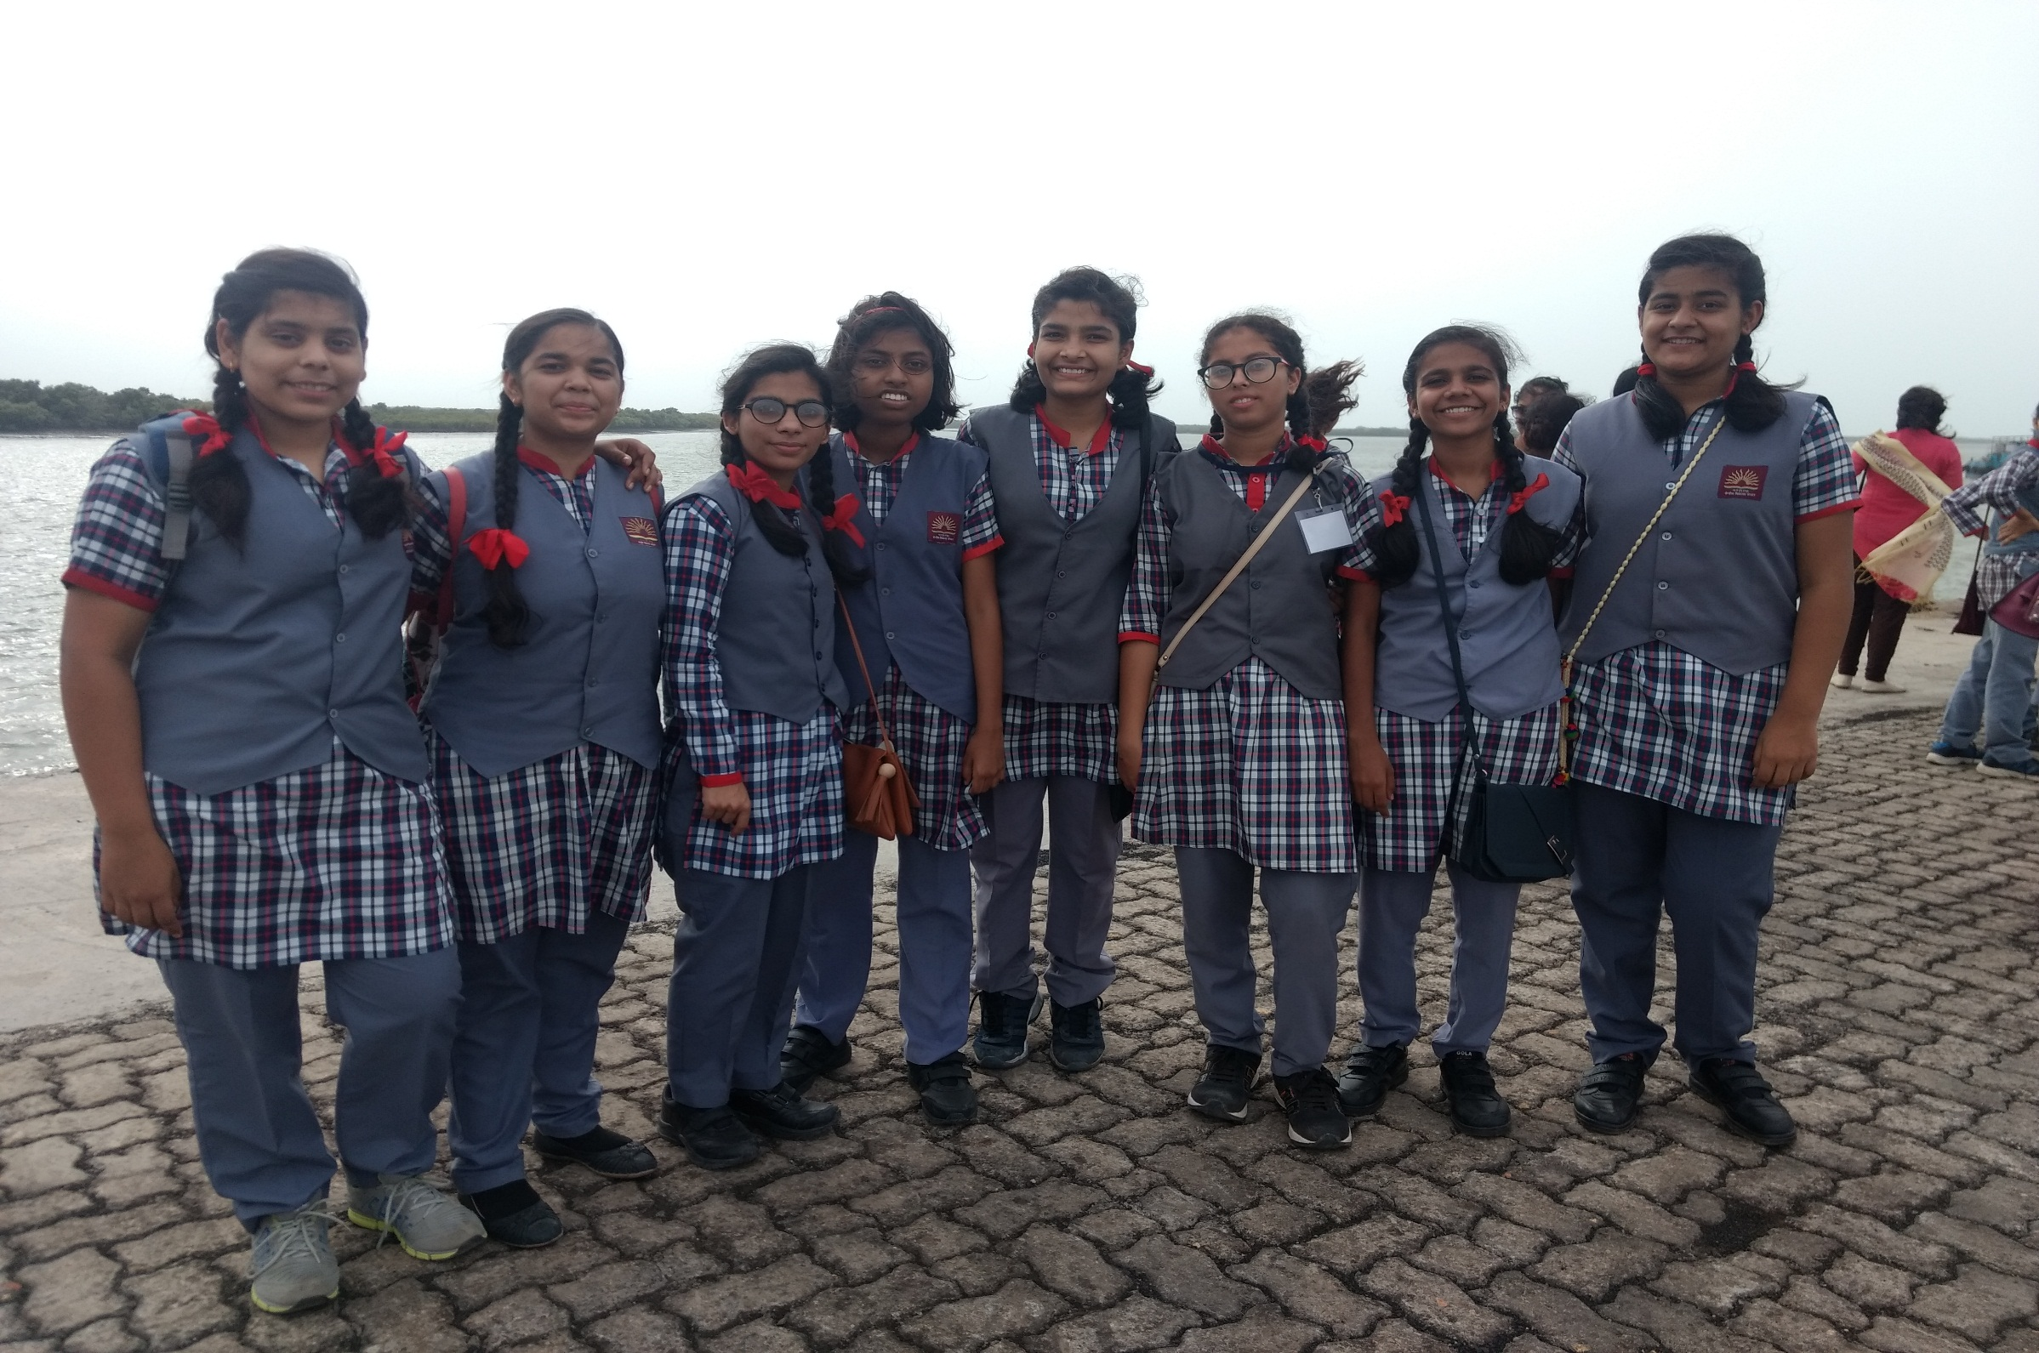

Slide 3
GIRLS PARTICIPATED FROM BHOPAL REGION
S. No. | NAME | K. V. | CLASS | STREAM
1. | KAJAL YADAV | MHOW | XI | PCM
2. | STUTI MISHRA | SHIVPURI | XI | COMMERCE
3. | PALAK DHOOT | PACHMARI | XI | COMMERCE
4. | RAKSHA THAKUR | BARWAHA | XI | PCM
5. | SANYAMI TIWARI | BINA | XI | PCM
6. | ANUSHKA B. | SEONI MALWA | XI | COMMERCE
7. | SONAM SINGH | BAIRAGARH | XI | PCB
8. | ANSHITA | NARMADA NAGAR | XI | PCM
9. | RUCHI SAHU | DEWAS | XI | PCM
10. | ANSHU PRIYA | KV 3, BHOPAL | XI | PCM

Slide 4
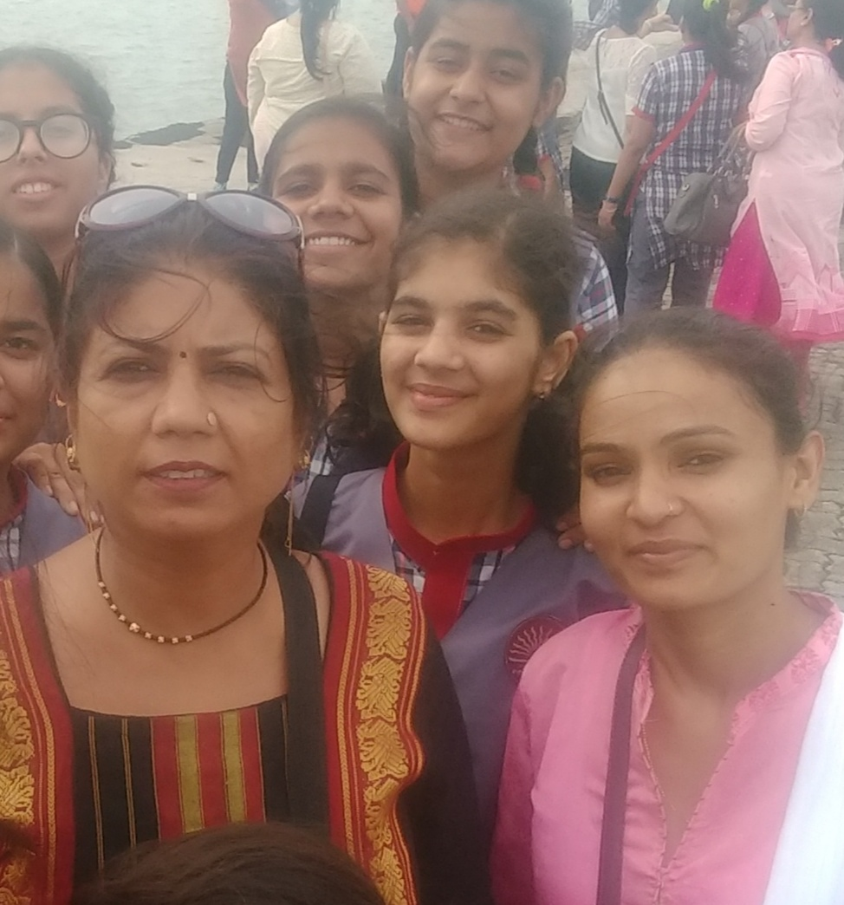
ESCORTS
1. | Mrs. ARCHANA SHRIVASTAVA LIBRARIAN KV BAIRAGARH
2. | Ms. POOJA S. TGT MATHS KV SEONI MALWA

Slide 5
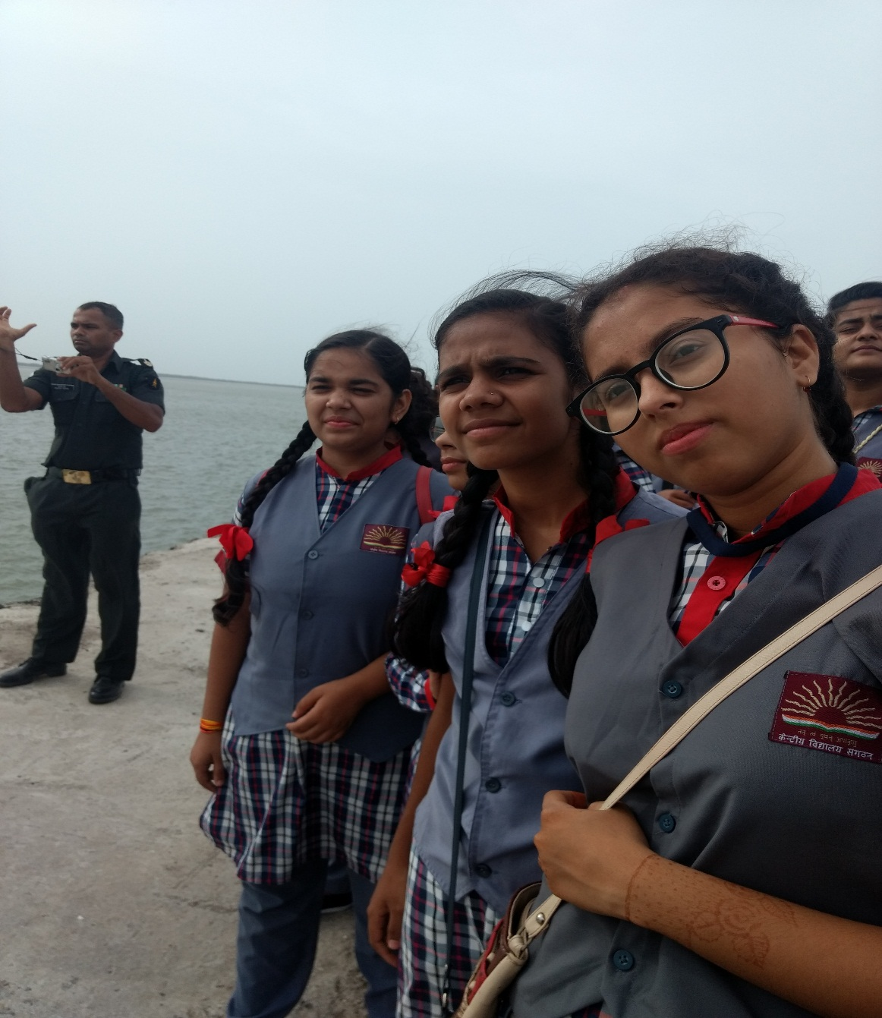
DAY–1/25.06.18
Visit to NAVEL BASE of Indian Navy- INS Valsura In the morning guided by the officers of Indian Navy Lt. Comm. K. Shrinivasan & Lt. Comm. Ravi Kumar. In the afternoon session after lunch went to BEDI PORT & ROZI PORT, the extreme corner of India bordered AREBIAN SEA

Slide 6
DAY II /26.06.2018
AIRFORCE STATION, JAMNAGAR
A very adventures and exciting visit for all girls under the wonderful guidance of squadron leader K. Aishvarya and Flying Officer Hina Jaiswal. A great experience to sea different type of fighter planes and missiles. All were personally experienced the take off and landing of fighter planes. Another special thing was to sit inside the new SUKHOI fighter air craft of Indian Air force. The Fighter Pilot explained all the details.

Slide 7
DAY III & IV,27 & 28.06.2018
INFANTRY LINES, JAMNAGAR
In first half, a very communicative session with Colonel ABHISHEK SHRIVASTAVA, who is a member of army selection board followed by a documentary shown the life and activities of a soldier in every corner of our country. Lieutenant KRATIKA explained the scope and opportunities for girls in Indian Army. She shared her sweet and sour experiences during army training from ballroom dancing to dark night adventure.
Second day in Infantry Line was totally dedicated to field activities specially Riffle Firing. Lt. Col. Vikas Bharadwaj, OSD, KVS HQ was with us all the time on ground and personally guided at the time of firing sessions. First the army persons gave a training to all the students and than gave a chance of firing of five rounds to each girl under the observation of trained army men. On a request to Mr. Bharadwaj, willing escort teachers also got a chance for firing practice. It was an amazing experience for all.

Slide 8
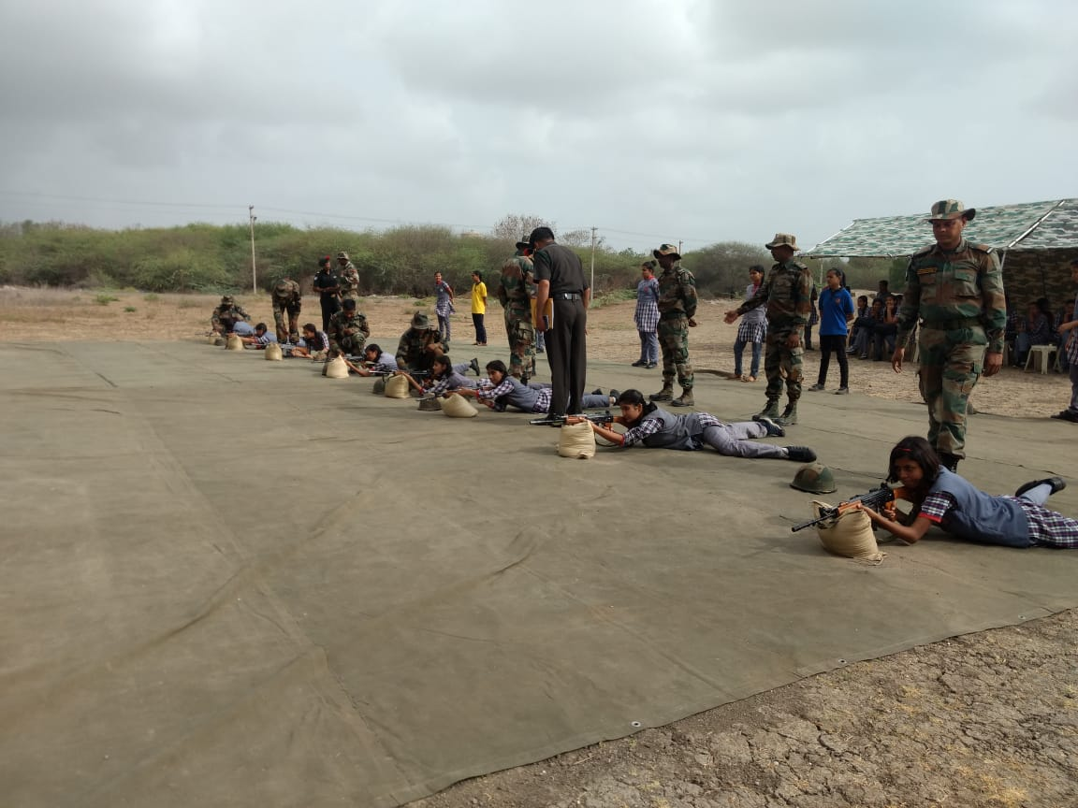
Firing Range, Army Station Jam Nagar
A Great Experience

Slide 9
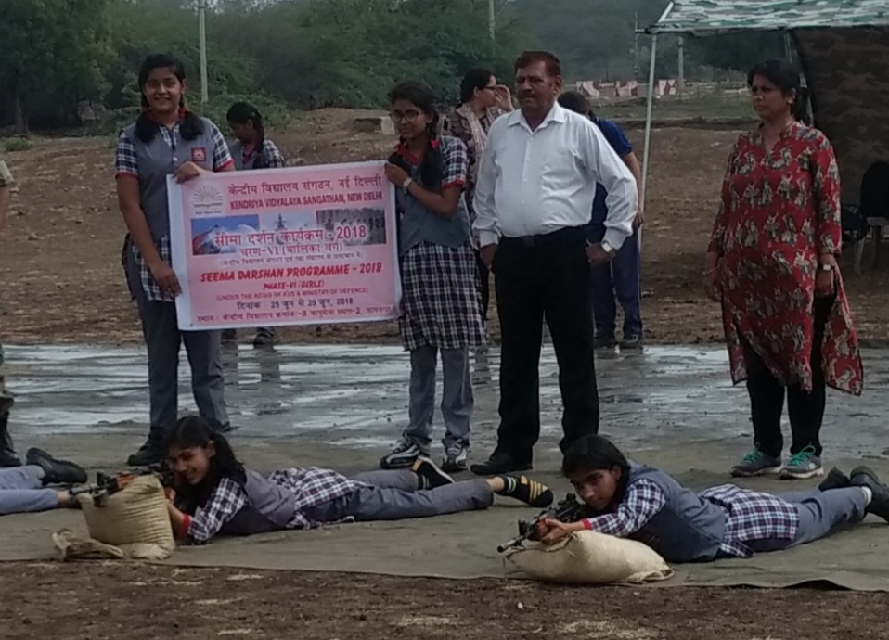

Slide 10
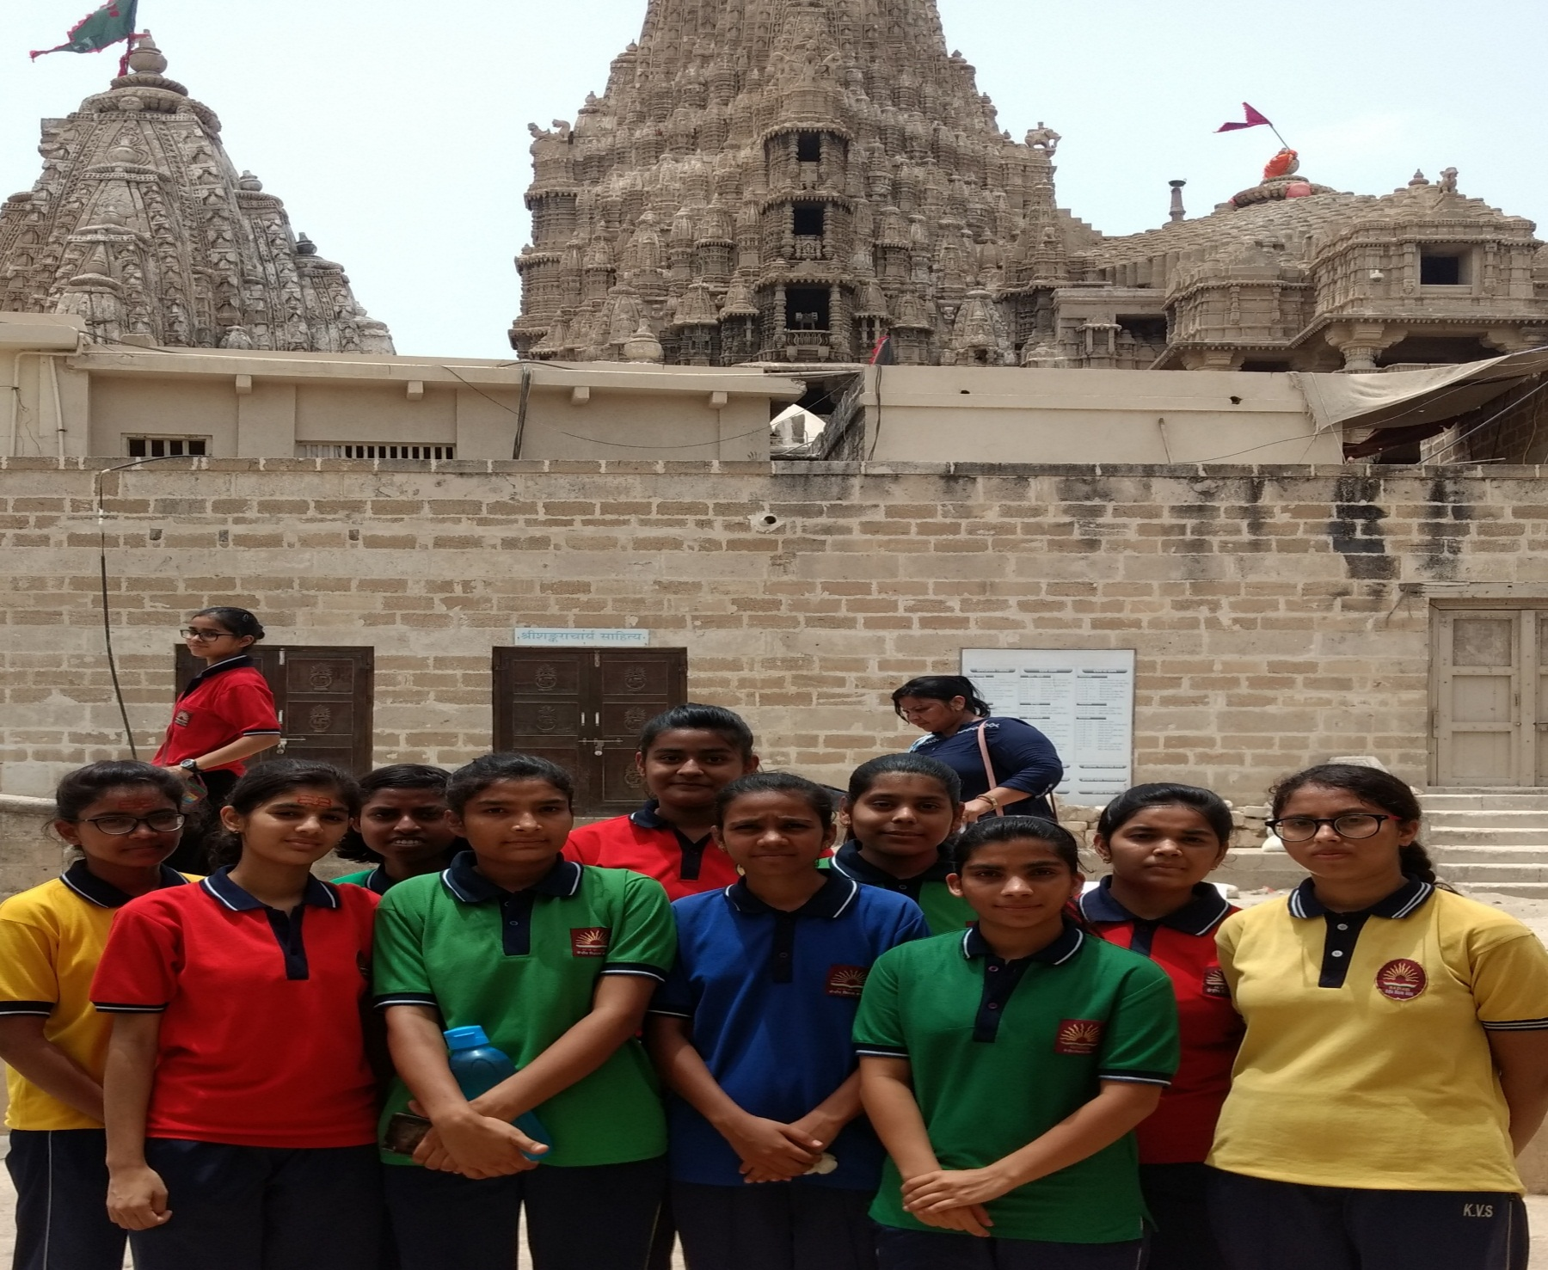
DAY- V 29.06.2018
VISIT TO
DWARIKA
TEMPLE
&
NAGESHWAR

Slide 11
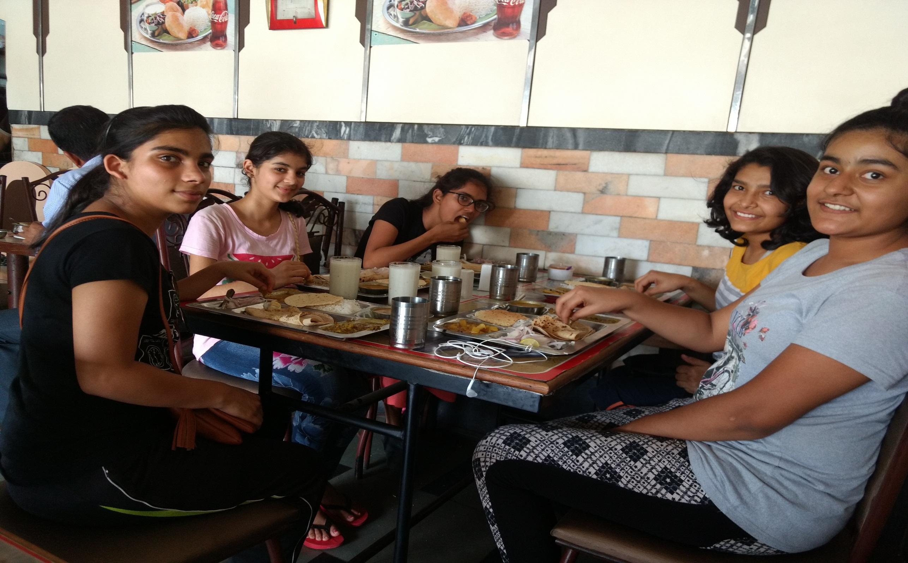
Delicious Gujrati Food

Slide 12
THANK YOU
THANTYOU

