Slide 1
LANGUAGE LAB IN KENDRIYA VIDYALAYAS

Slide 2
WHY LANGUAGE LAB.
Listening, Speaking, Reading and Writing are the four skills which play an important role in the acquisition of language and learning.
The importance of language cannot be mitigated even if so desired.
It is almost necessary that a learner has a good command over the language to allow him overall success in life.

Slide 3
WHY LANGUAGE LAB.
Having clarity and accuracy of the English language gives confidence to the learner and opens doors to avenues otherwise out of reach.
It is thus vital, that provisions be made to enhance the skills of the learners of this global language.

Slide 4
NEED OF LANGUAGE LAB.
The language lab is an extremely useful tool that facilitates class room engagement and interaction via computer based activities and exercises to increase language immersion.
It enhance their English, whether for work, personal enrichment or English for Academic Purposes.
Language labs give completely different experience from the traditional system of learning languages and teaching, offering advanced features and functionalities.

Slide 5
NEED OF LANGUAGE LAB.
A good English language lab when established and used by an institute can do wonders for the learners.
The learners develop a continuous interest to learn the language as it encourages them to understand it and facilitates the understanding of the concepts of the language.
English language labs are designed to provide the learners with a strong platform for practical training in the language.

Slide 6
NEED OF LANGUAGE LAB.
A good language lab skillfully and efficiently develops the language skills of the learners.
They are exposed to functional language in use and are familiarized with the many pronunciation styles that are vital in everyday usage of the English language in today’s world.

Slide 7
NEED OF LANGUAGE LAB.
When a blended methodology of language teaching is adopted in a language lab, the human touch brought in by a teacher (during the classroom section of the language lab) ensures a live delivery of language concepts.
These concepts are discussed and where need be demonstrated by the teacher before the learners proceed to practice them individually in the computer based section of the language lab.
Learners hence get ample scope for practice and internalization of language concepts. Language labs also provide scope for using English language through games and practice exercises to polish concepts learnt during classroom sessions.

Slide 8
NEED OF LANGUAGE LAB.
The need for having a language lab is being widely recognized by the English language academia.
Schools and colleges across the country are opening up to the idea of establishing language labs for the future benefit of their learners.

Slide 9
LL in KVS
In phase I of establishment of language labs in Kendriya Vidyalayas, a total of 276 language labs were established all over the country out of which 13 were established in Bhopal Region.

Slide 10
The items delivered from KVS (HQ) through various vendors for establishment for language labs are:
Digital Language Lab Software supplied by M/s Globus Infocom Ltd.
Desktop computers (Model HP Elite Desk 705 GSFF) supplied by M/s Iris Computers Ltd. with three years warranty from the date of installation
Arm Chairs Supplied by M/s Kings Furnishings and safe company with one year warranty
Work stations Supplied by M/s Llyod safe company with one year warranty
Trainer Manual, work books and flash cards supplied by Words worth English Language Lab.
Headphones supplied by M/s Globus Infocom Ltd.

Slide 11
Work Stations in LL

Slide 12
Step by step work and its monitoring at Vidyalaya level:
Constitute a language lab committee comprising Principal, language Lab Incharge, WET, Furniture Incharge, & one student member (Suggestive) for inspection of lab and its functioning.
Designate room for establishment of language lab and keep it ready with cleaning and color wash/painting.
Monitoring of installation of Arm chairs and work stations by the vendors, at the time of delivery from vendor, check all items before taken over then only sign on consignee receipt or delivery challan and ensure that the entries have been made in the concerned stock register.

Slide 13
Step by step work and its monitoring at Vidyalaya level:
Electrification work in work stations and language lab.to be done at Vidyalaya level (Electric switches, modular plates, 6amp switch, 6 amp socket, computer data cable for LAN wiring will not be supplied by any vendor and its expenditure will be borne by the concerned Vidyalaya)
After delivery of furniture items contact to the vendors to install computers and software for language lab. respectively.
Monitor installation of Desktop computers and Language lab software by the vendors

Slide 14
Step by step work and its monitoring at Vidyalaya level:
LAN connection in all computers to be done at Vidyalaya level
Arrange training of teachers at vidyalaya level by Master trainer from Words worth English Language Lab.

Slide 15
The Words worth language lab software
The Words worth language lab software is user friendly and the soul of language lab.
It is the combination of classroom sessions (Instructor-led training ILT) and language lab sessions (Computer based training CBT).
It focus on language development through activities and consolidation exercises, pronunciation and speaking practices, role play, problem solving, review exercises, listening practice through built in audio and self-study.
The need of language development is catered through a combination of alternating grammar and vocabulary sessions.
The sessions are not mutually exclusive, grammar is reinforced in the vocabulary sessions and vice versa.

Slide 16
Features of the Words worth Language Lab software
Trainer manual for conducting a session which focuses on the main objectives of the session.
Flash cards to refer for guidelines while conducting the actual session.
The workbooks replicate the classroom software.
On screen instructions appear on each activity in the software. The trainer manual has similar instructions.
Audio files are built into the classroom software. The audio button allows to replay audio files as often as needed to ensure understanding.
Solved examples are given with activities.

Slide 17
Features of the Words worth Language Lab software
Also show answer buttons are provided to see the correct answers of displayed questions.
Pair work is encouraged in the software.
Free speech is built into every activity towards the end of the programme.
The pace of the course will vary depending on the average learner.

Slide 18
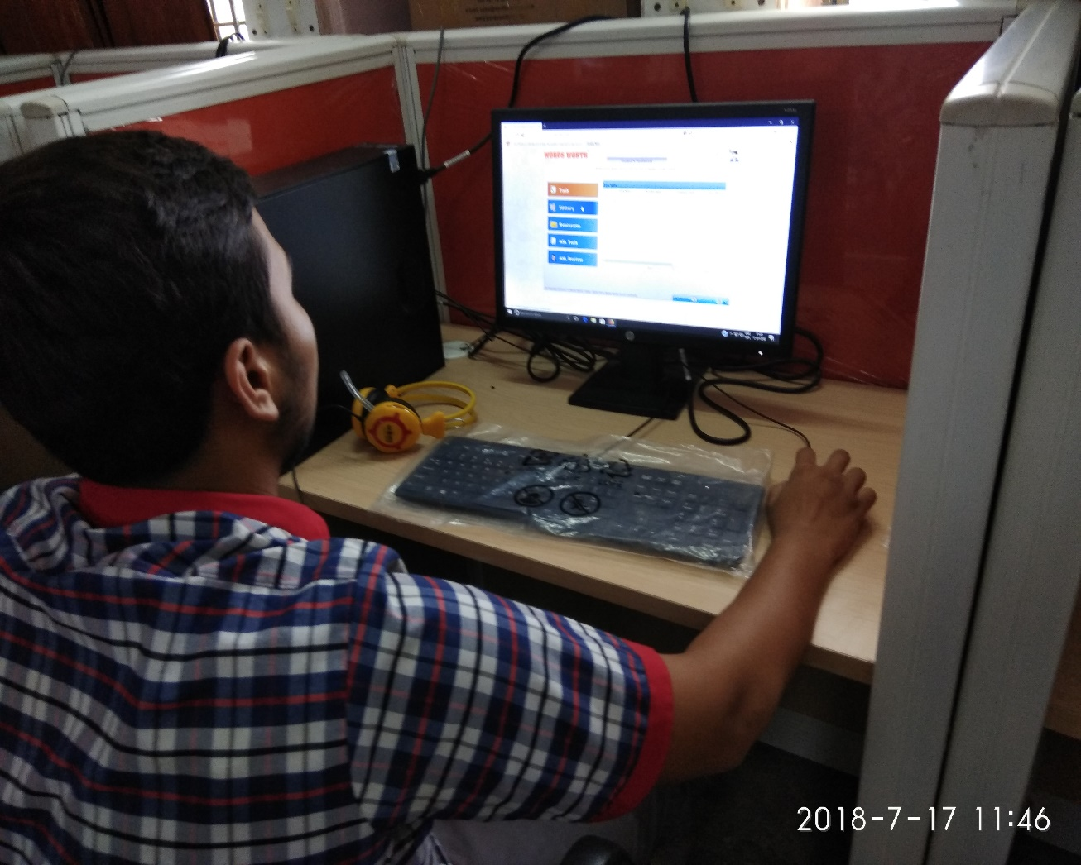

Slide 19
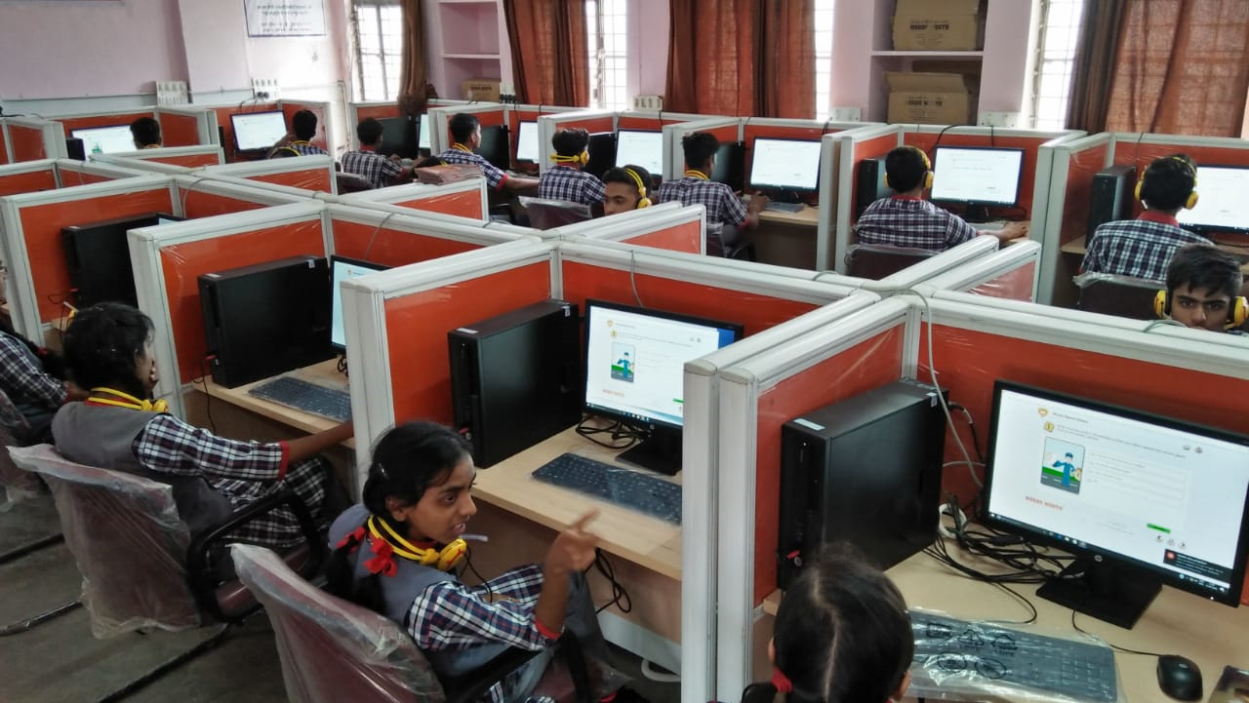

Slide 22
Links for demo of LL Software
http://www.wordsworthelt.com/wwDemo25/resources/module-1/CBT/m01s01p01.html
http://www.wordsworthelt.com/wwDemo25/

