Slide 1
IMPLEMENTATION OF PROJECT “JIGYASA” IN KENDRIYA VIDYALAYAS BHOPAL REGION

Slide 3
INTRODUCTION
“JIGYASA” is one of the major initiative taken up by CSIR at national level, during its Platinum Jubilee Celebration Year. CSIR is widening and deepening its Scientific Social Responsibility further with the programme.

Slide 4
Jigyasa, a student - scientist connect programme has been launched by the government in New Delhi. The programme would be implemented by the Council of Scientific and Industrial Research (CSIR) in collaboration with Kendriya Vidyalaya Sangathan (KVS).
"JIGYASA" is one of the major initiative taken up by CSIR at national level, during its Platinum Jubilee Celebration Year. CSIR is widening and deepening its Scientific Social Responsibility further with the programme. Council of Scientific and Industrial Research (CSIR), has joined hands with Kendriya Vidyalaya Sangathan (KVS) to implement this programme. The focus of this scheme is on connecting school students and scientists so as to extend student's classroom learning with well planned research laboratory based learning.

Slide 5
HIGHLIGHTS OF THE JIGYASA PROGRAMME
JIGYASA' would inculcate the culture of inquisitiveness on one hand and scientific temper on the other, amongst the school students and their teachers.
The programme will also enable the students and teachers to practically live the theoretical concepts taught in science by visiting CSIR laboratories and by participating in projects.
The Programme is expected to connect 1151 Kendriya Vidyalayas with 38 National Laboratories of CSIR targeting 100,000 students and nearly 1000 teachers annually.
The focus is on connecting school students and scientists to extend student's classroom learning with a well planned research laboratory based learning.
It will also enable the students and teachers to practically live the theoretical concepts taught in science by visiting CSIR laboratories and by participating in mini-science projects.

Slide 6
“JIGYASA” - Student-Scientist connect programme launched Signing of MoU between CSIR & KVS Student-Scientist connect programme “JIGYASA”.

Slide 7
1151 Kendriya Vidyalayas connect with 38 CSIR Laboratories targeting one lakh students and nearly 1000 teachers annually
Jigyasa, a student- scientist connect programme was officially launched in the national capital today. Council of Scientific and Industrial Research (CSIR), has joined hands with Kendriya Vidyalaya Sangathan (KVS) to implement this programme. The focus is on connecting school students and scientists so as to extend student’s classroom learning with that of a very well planned research laboratory based learning.
Memorandum of Understanding signing ceremony was held in the presence of Dr. Harsh Vardhan, Minister of Science & Technology, Earth Sciences, Environment, Forests and Climate Change and Shri Prakash Javadekar, Minister of Human Resource Development.

Slide 8
The “JIGYASA” would inculcate the culture of inquisitiveness on one hand and scientific temper on the other, amongst the school students and their teachers. The Programme is expected to connect 1151 Kendriya Vidyalayas with 38 National Laboratories of CSIR targeting 100,000 students and nearly 1000 teachers annually.

Slide 9
The program will also enable the students and teachers to practically live the theoretical concepts taught in science by visiting CSIR laboratories and by participating in mini-science projects. The model of engagement includes:
· Student Residential Programmes;
· Scientists as Teachers and Teachers as Scientists;
· Lab specific activities / Onsite Experiments;
· Visits of Scientists to Schools/Outreach Programmes;
· Science and Maths Clubs;
· Popular Lecture Series/ demonstration programme at Schools;
· Student Apprenticeship Programmes;
· Science Exhibitions;
· Projects of National Children’s Science Congress;
· Teacher Workshops; and
· Tinkering Laboratories.

Slide 10
Glimpse under Jigyasa Programme at CSIR -AMPRI

Slide 11
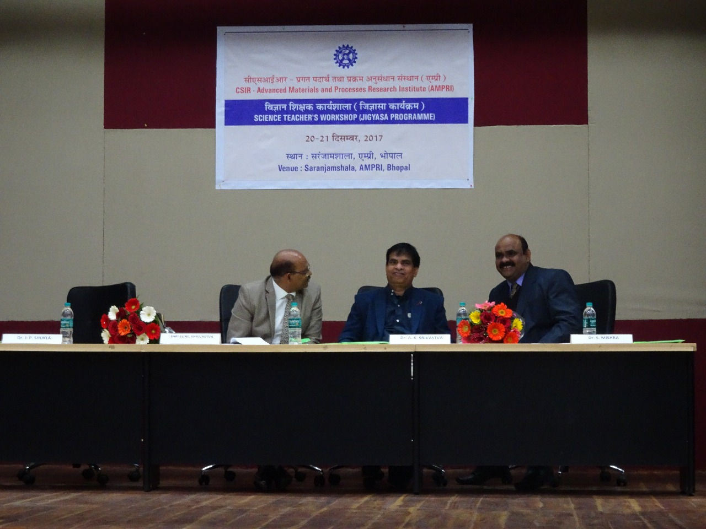

Slide 12
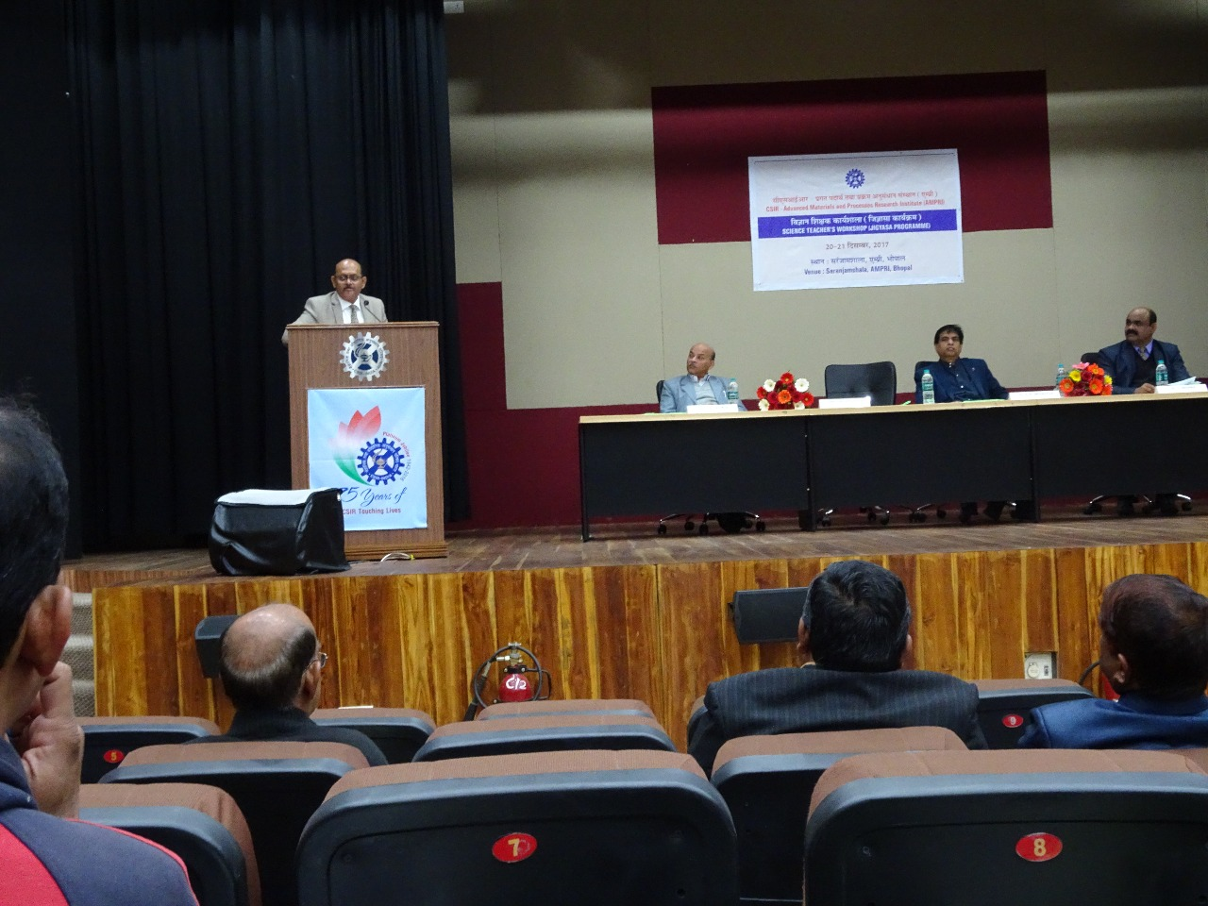

Slide 13
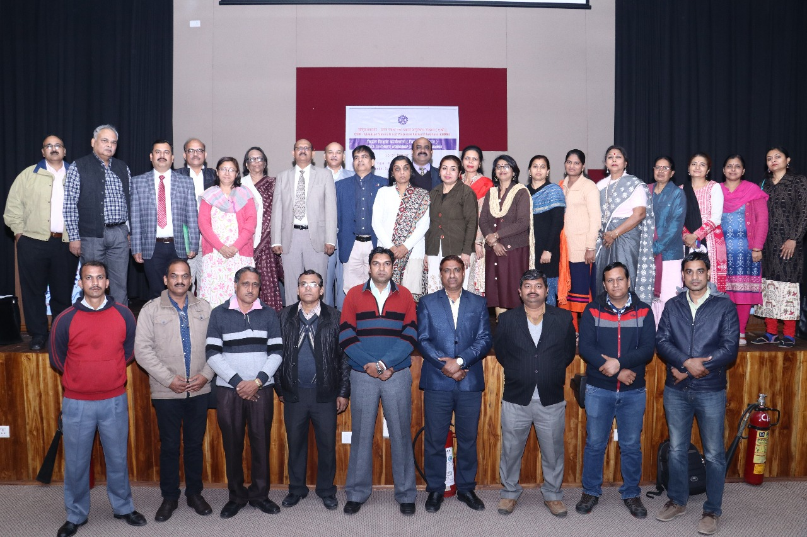

Slide 14
Calendar of Activities Academic Session 2018-19

Slide 15
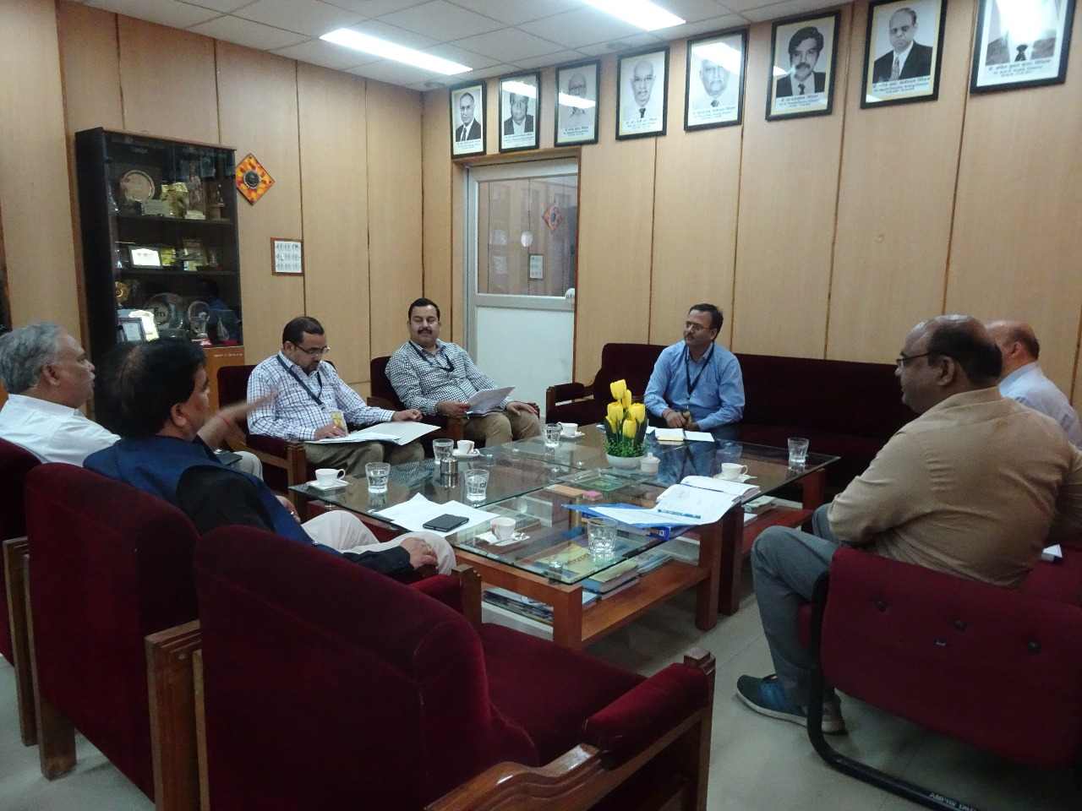

Slide 17
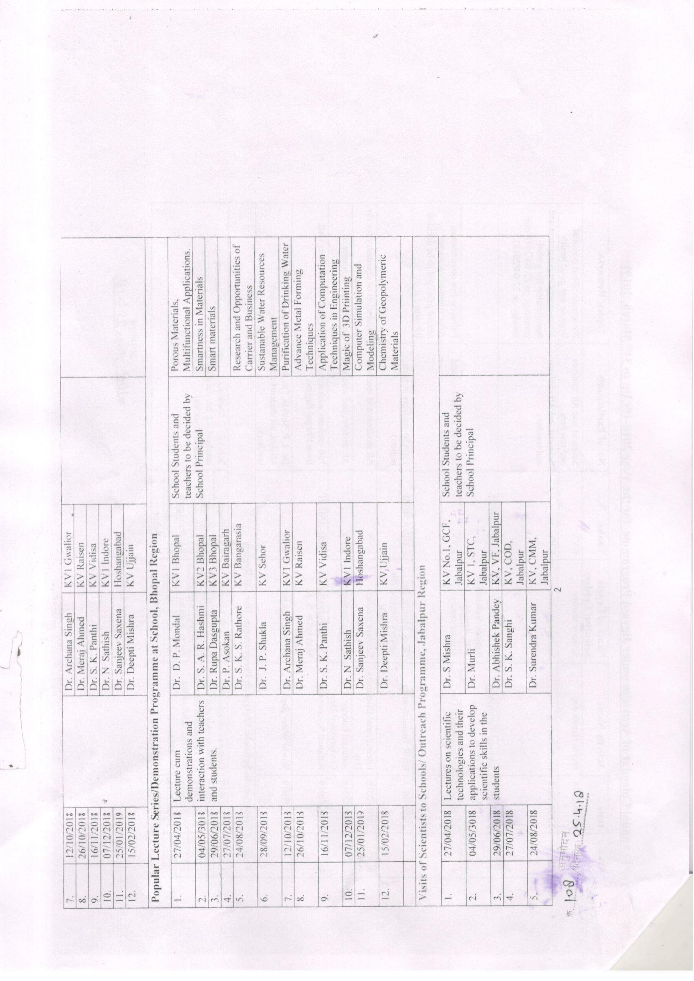

Slide 19
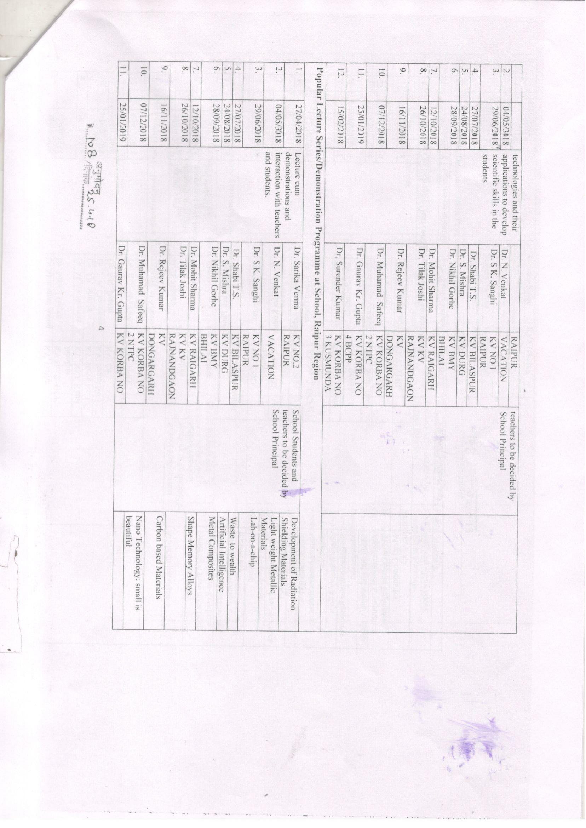

Slide 20
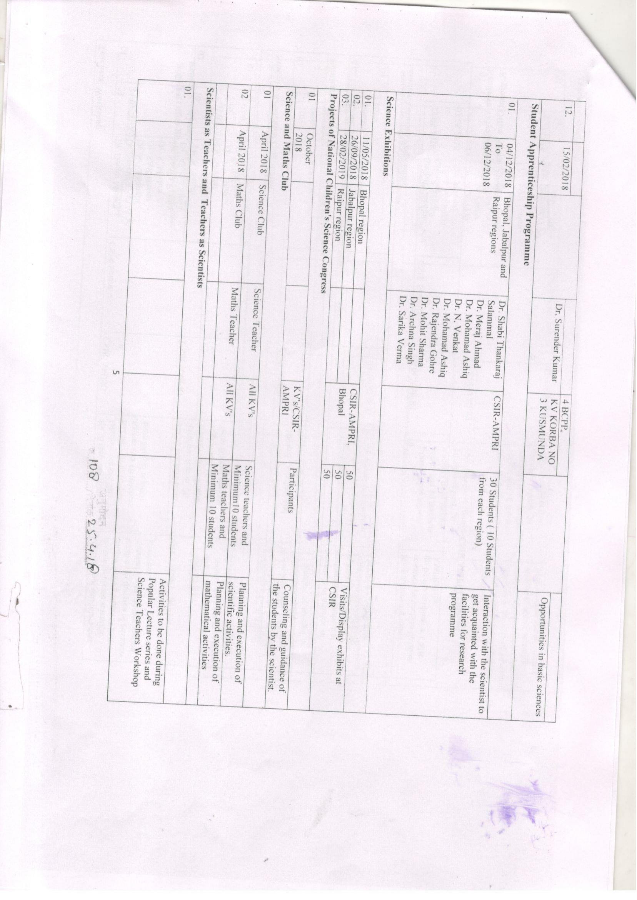

Slide 21
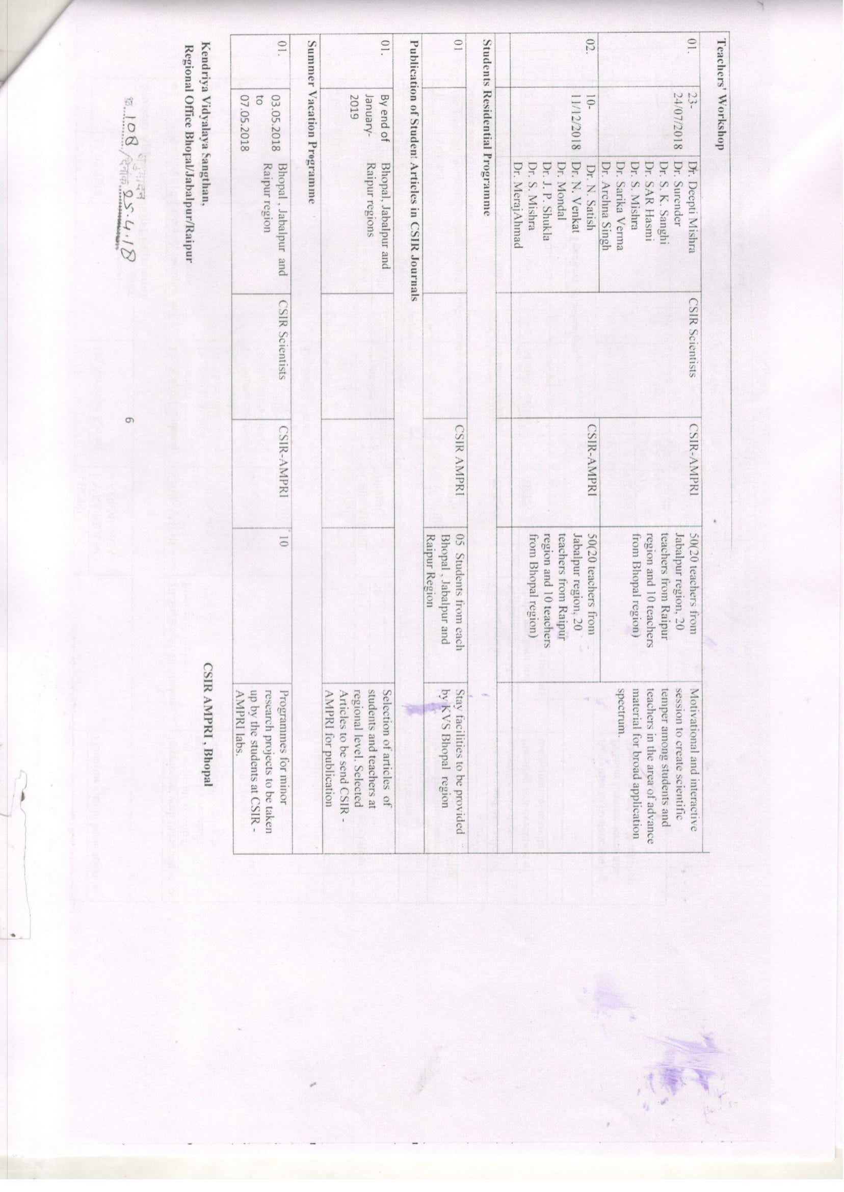

Slide 22
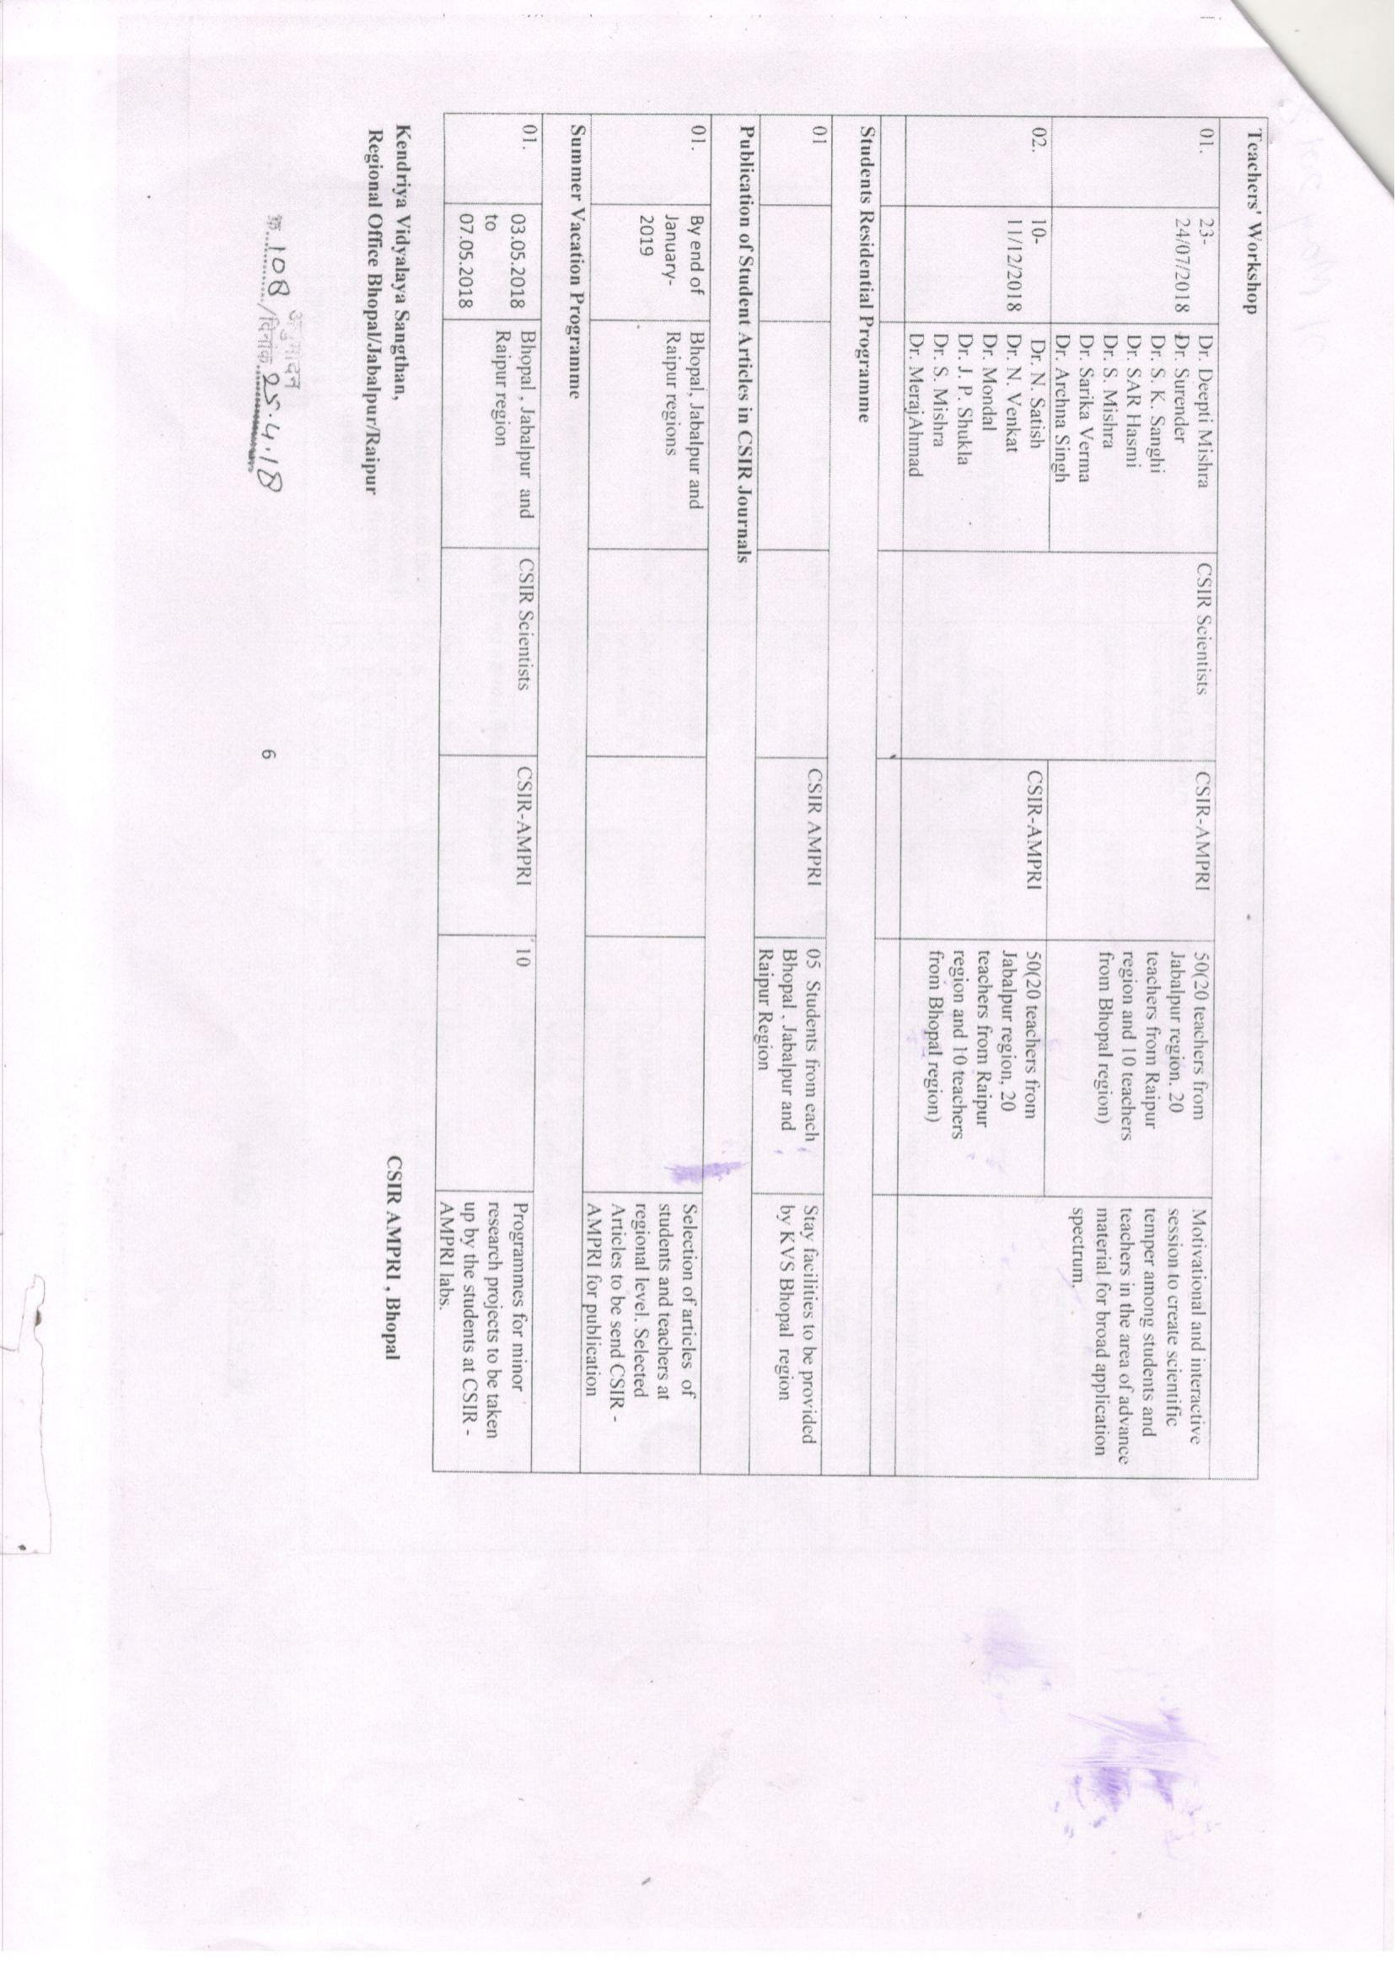

Slide 23
Kendriya Vidyalaya No. 2 Bhopal Science Club under “Jigyasa” Programme
Opportunities to the learners to explore aspects of Science.
The development of scientific attitude and critical thinking.
The interaction with scientists and acquaint with their research work.
The enhancement of the positive experiences that learners have with science by allowing them to explore their own ideas and interest.
Students in touch with the recent advances in science and use of technology.

Slide 24
Organizational Structure of Science Club Principal, Science teachers and students
Activities under Jigyasa programme.
Activities and day celebration related to Science and technology, scientist, researches
Interaction between Scientist and student teachers.
Science Exhibition
NCSC
Publication of students article in CSIR journals
Science olympiad

Slide 25
World Health DAY 07 APR 2018
The World Health Day was observed in the morning assembly on 07.04.2018 in the Vidyalaya under Jigyasa programme. Dr. Sushma Pippal stressed upon the do’s and don’ts of good health. She explained to follow the fitness regime, importance of fruits and vegetables. She advised the students not to use fast food. She demonstrated the correct way of hand wash. She informed regarding communicable diseases and their prevention. She provided the tips to keep the environment clean and to maintain personal hygiene. Mrs. Sadhana Shrivastava described the World Health Day and she delivered a lecture by highlighting the importance of the various parameters on the health of the human being. Shri S. K. Pathak, Principal addressed the students about the importance of healthy eating habits, sports and exercise for good health.

Slide 26
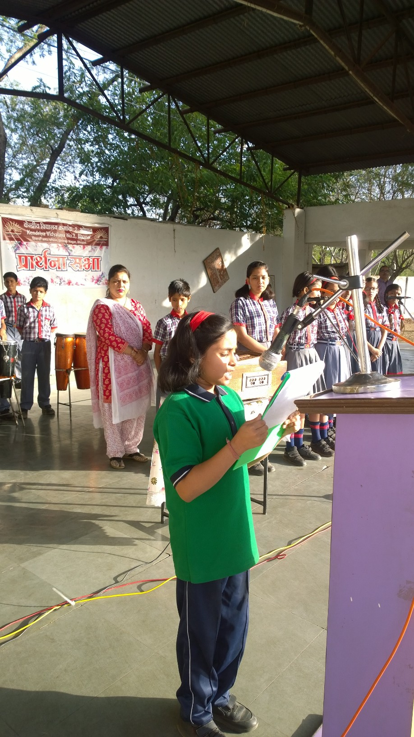
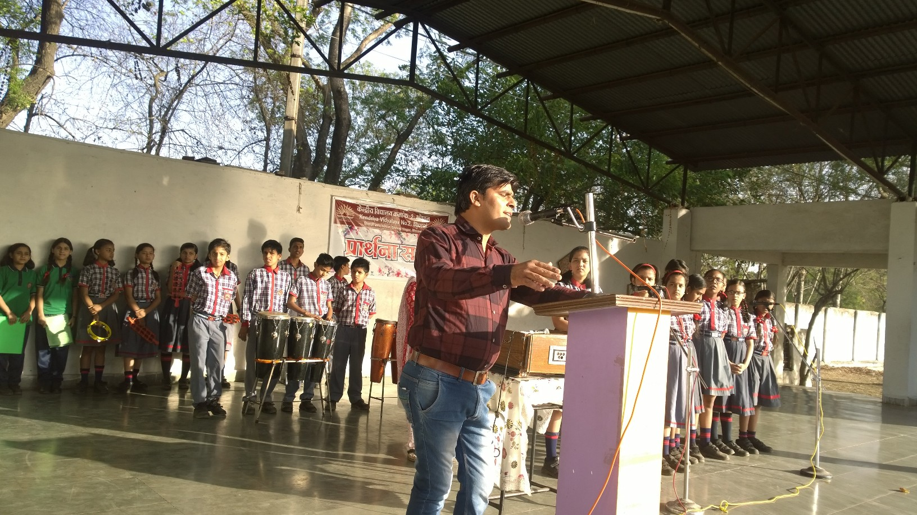
Earth Day 22.Apr.2018
The Earth Day was celebrated in the morning assembly on 22.04.2018 in the Vidyalaya under Jigyasa programme. It was a great day of environmental education for efforts to green the school. The students reflected their ideas on “Earth my home” through poster competition. Mr. Ashok Kumar Verma explained the aspects of the Earth Day and he introduced the various technologies for beneficial of the human life on the planet Earth. Principal suggested the students to follow environmental friendly practices.

Slide 27
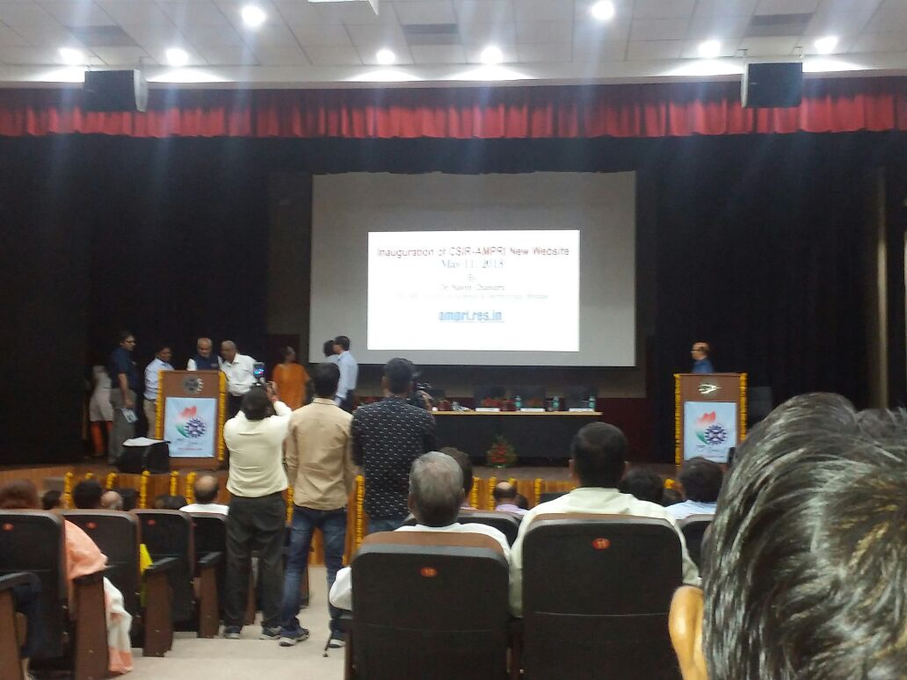
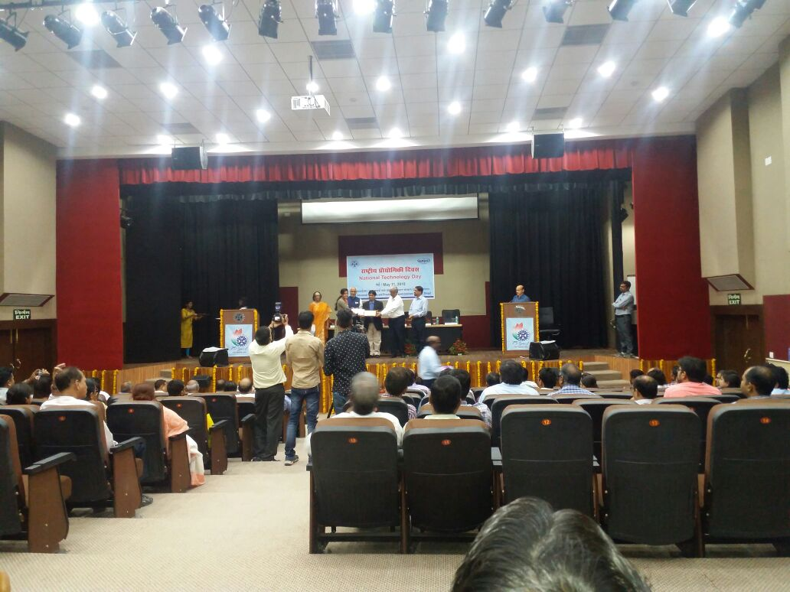
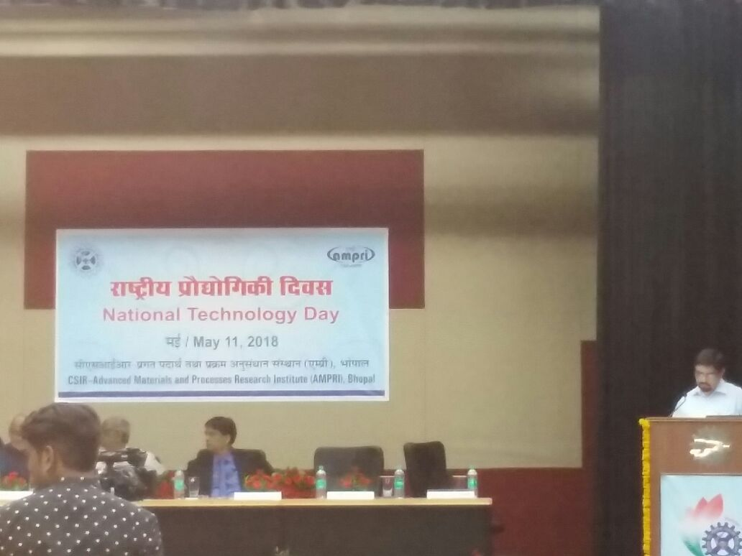
National Technology Day 11.05.2018
Theme: Science and Technology for sustainable future

Slide 28
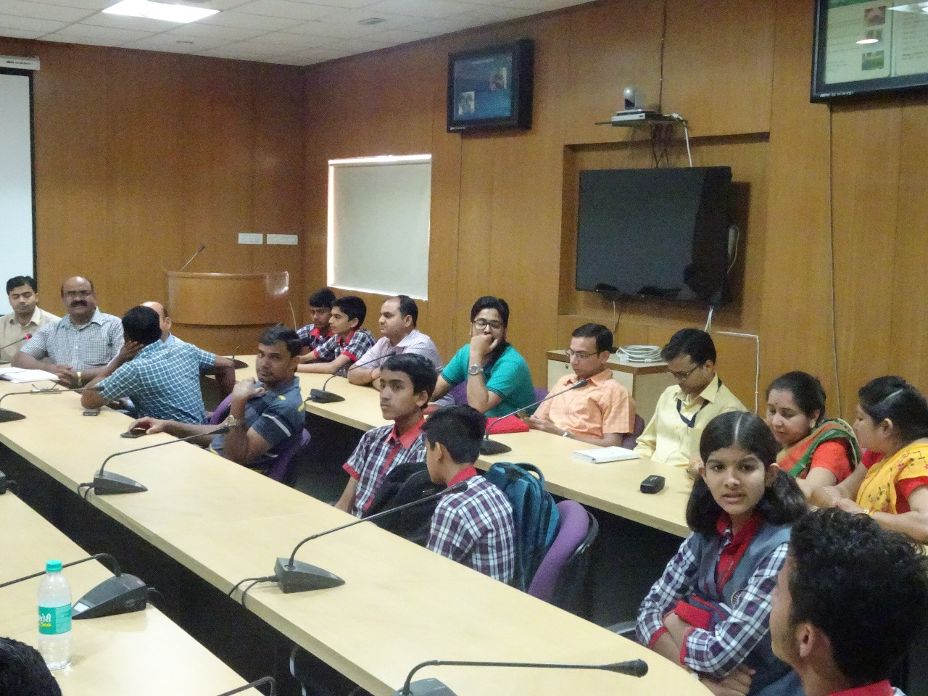

Slide 29
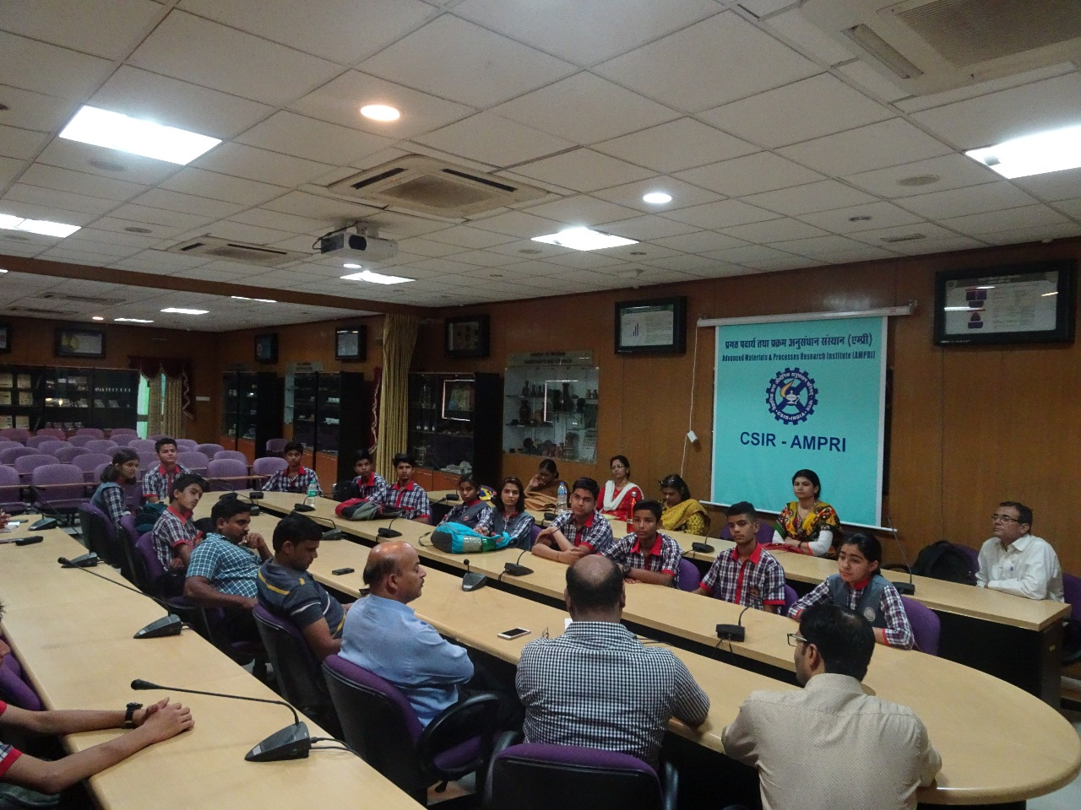

Slide 30
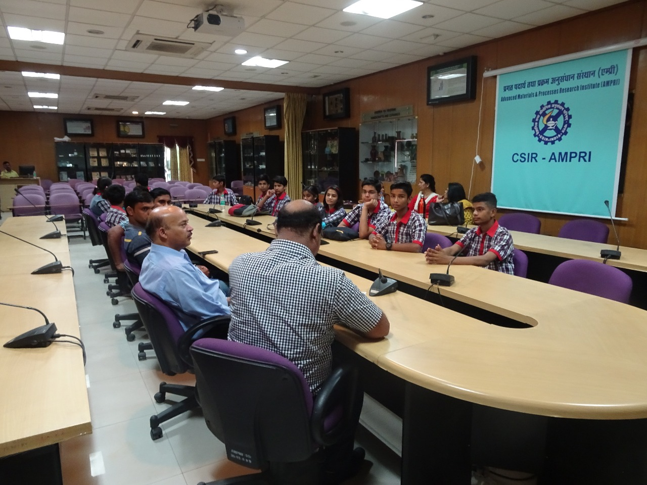

Slide 31
Summer Vacation programme
Programmes for minor research projects were taken by the students of Bhopal, Jabalpur and Raipur Region at CSIR – AMPRAI labs, Bhopal from 03.05.2018 to 07.05.2018. The students were familiarized with the projects, experiments and research work in the laboratories. The scientists explained the correct scientific methods to design and work on a project.

Slide 32
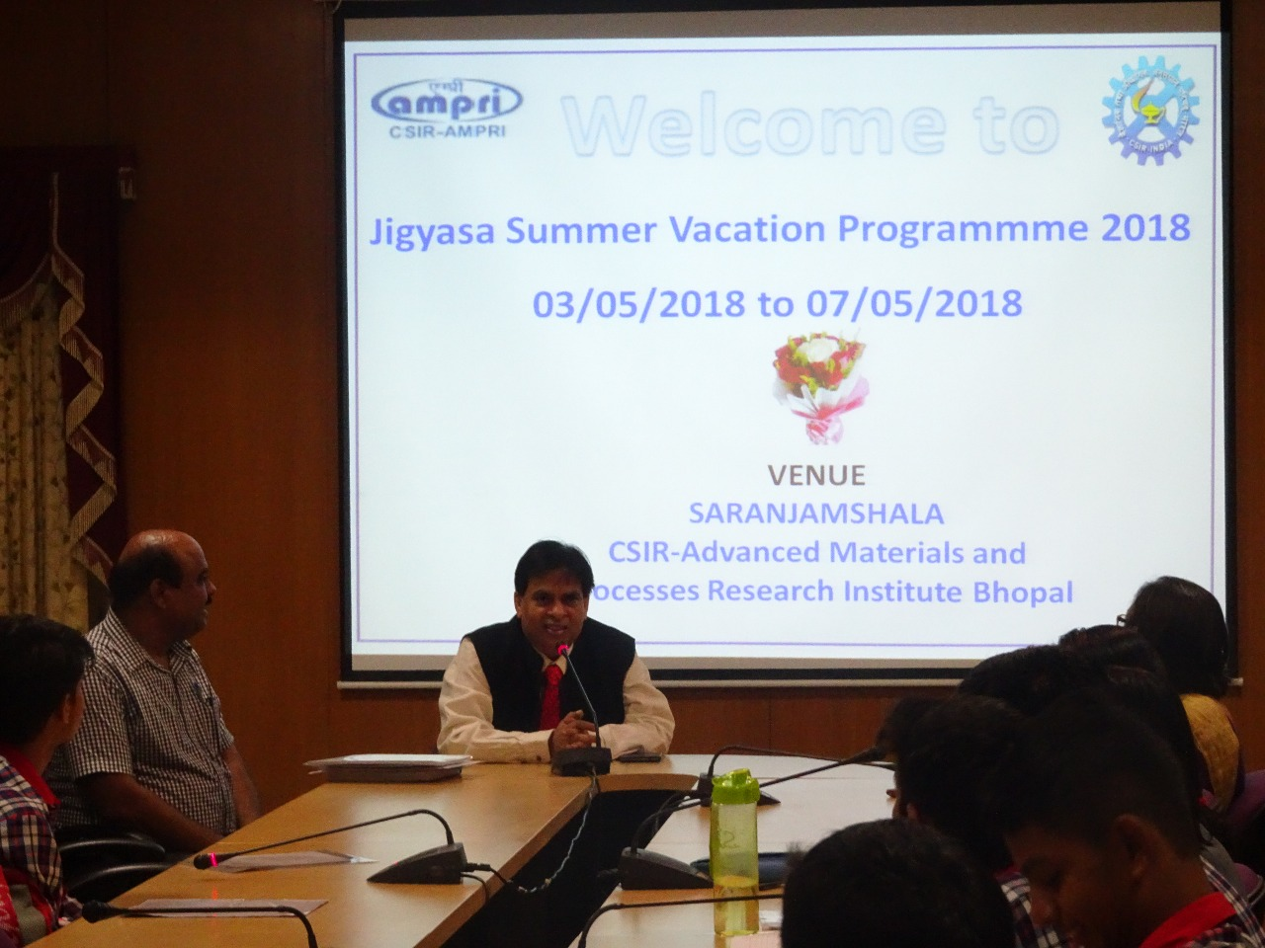

Slide 33
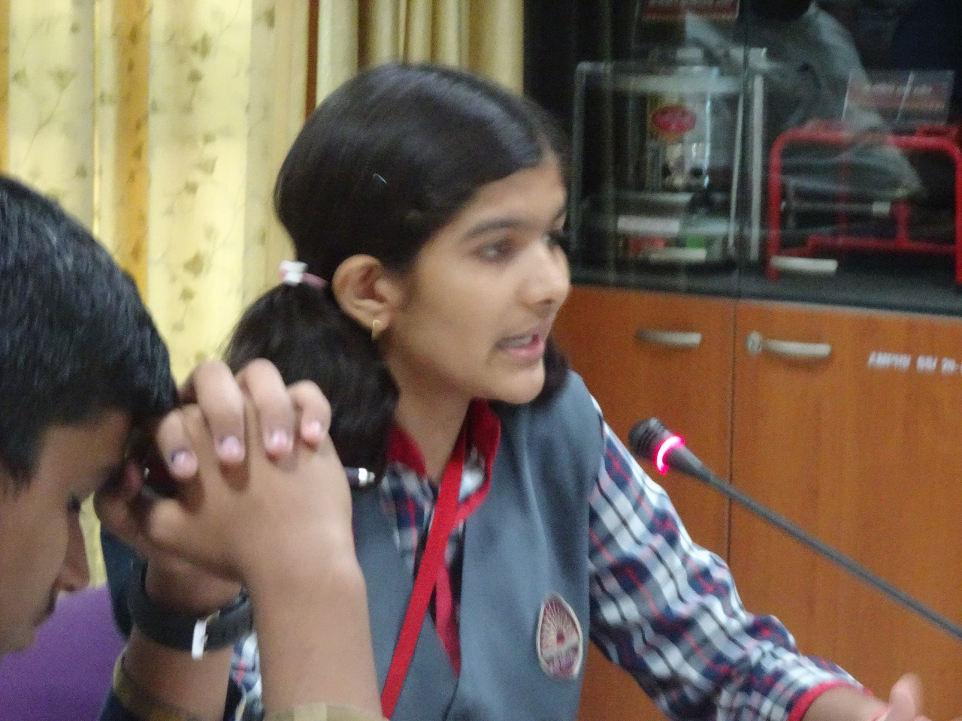

Slide 34
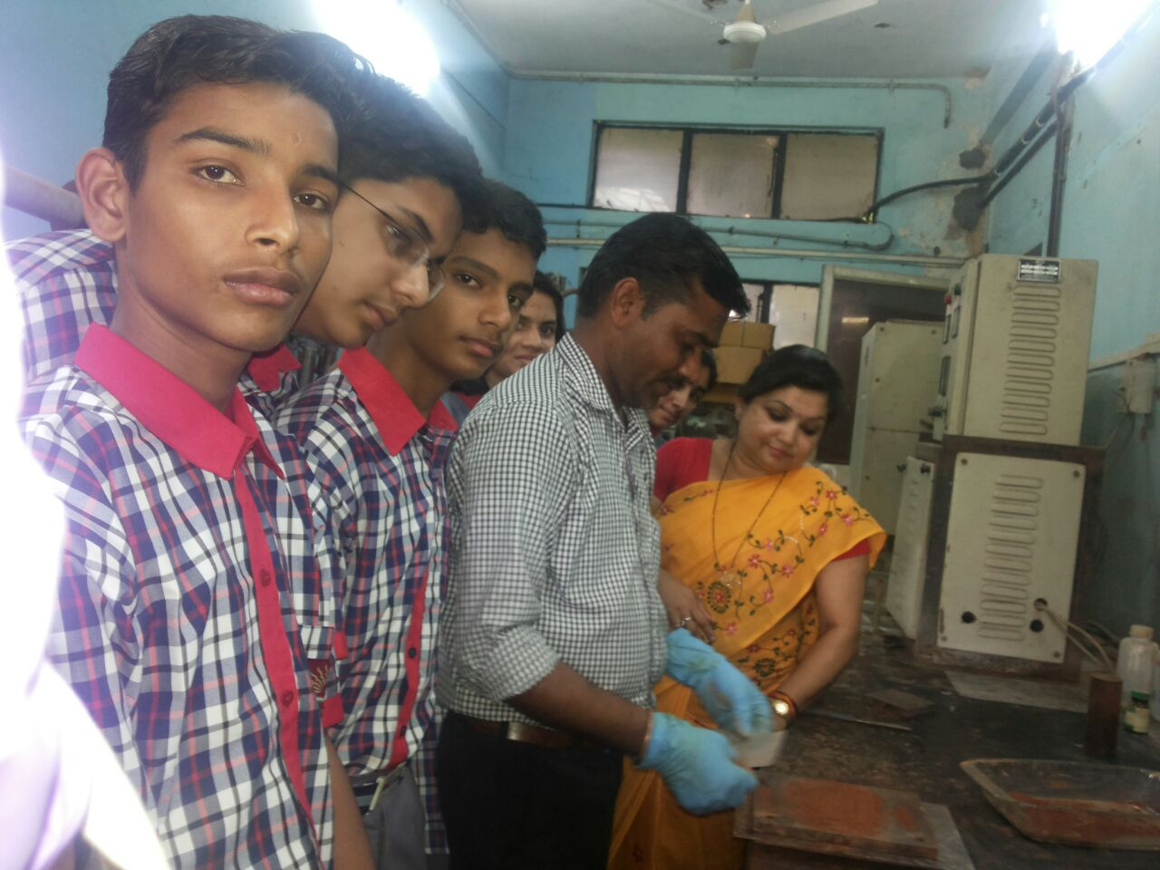

Slide 35
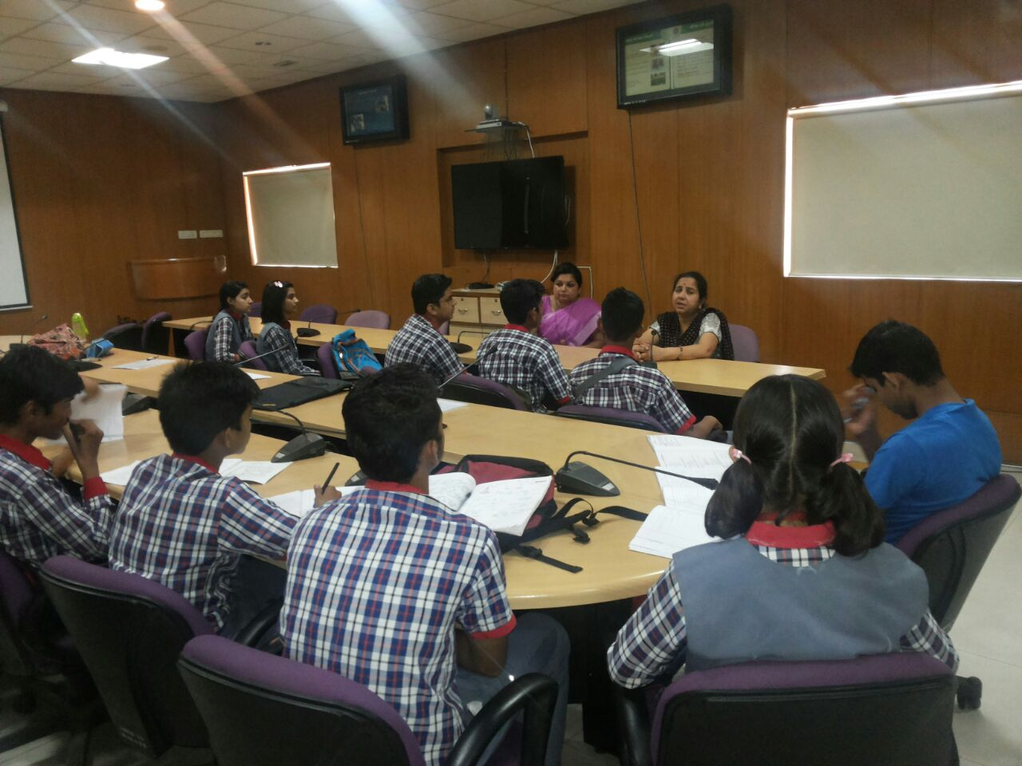

Slide 36
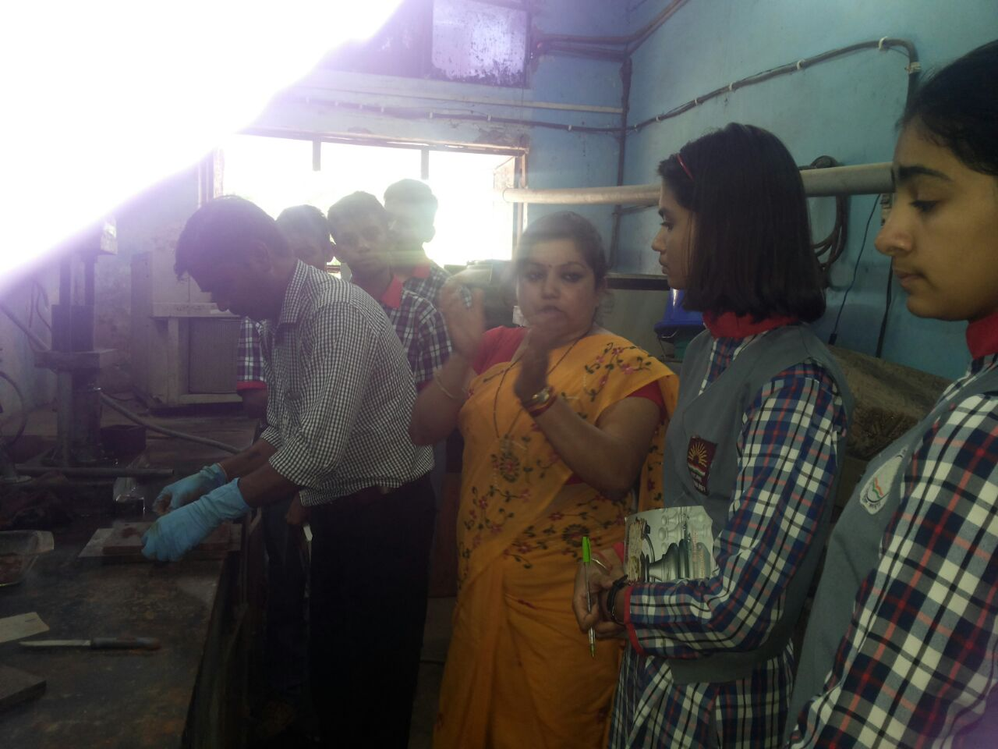

Slide 37
