Slide 1
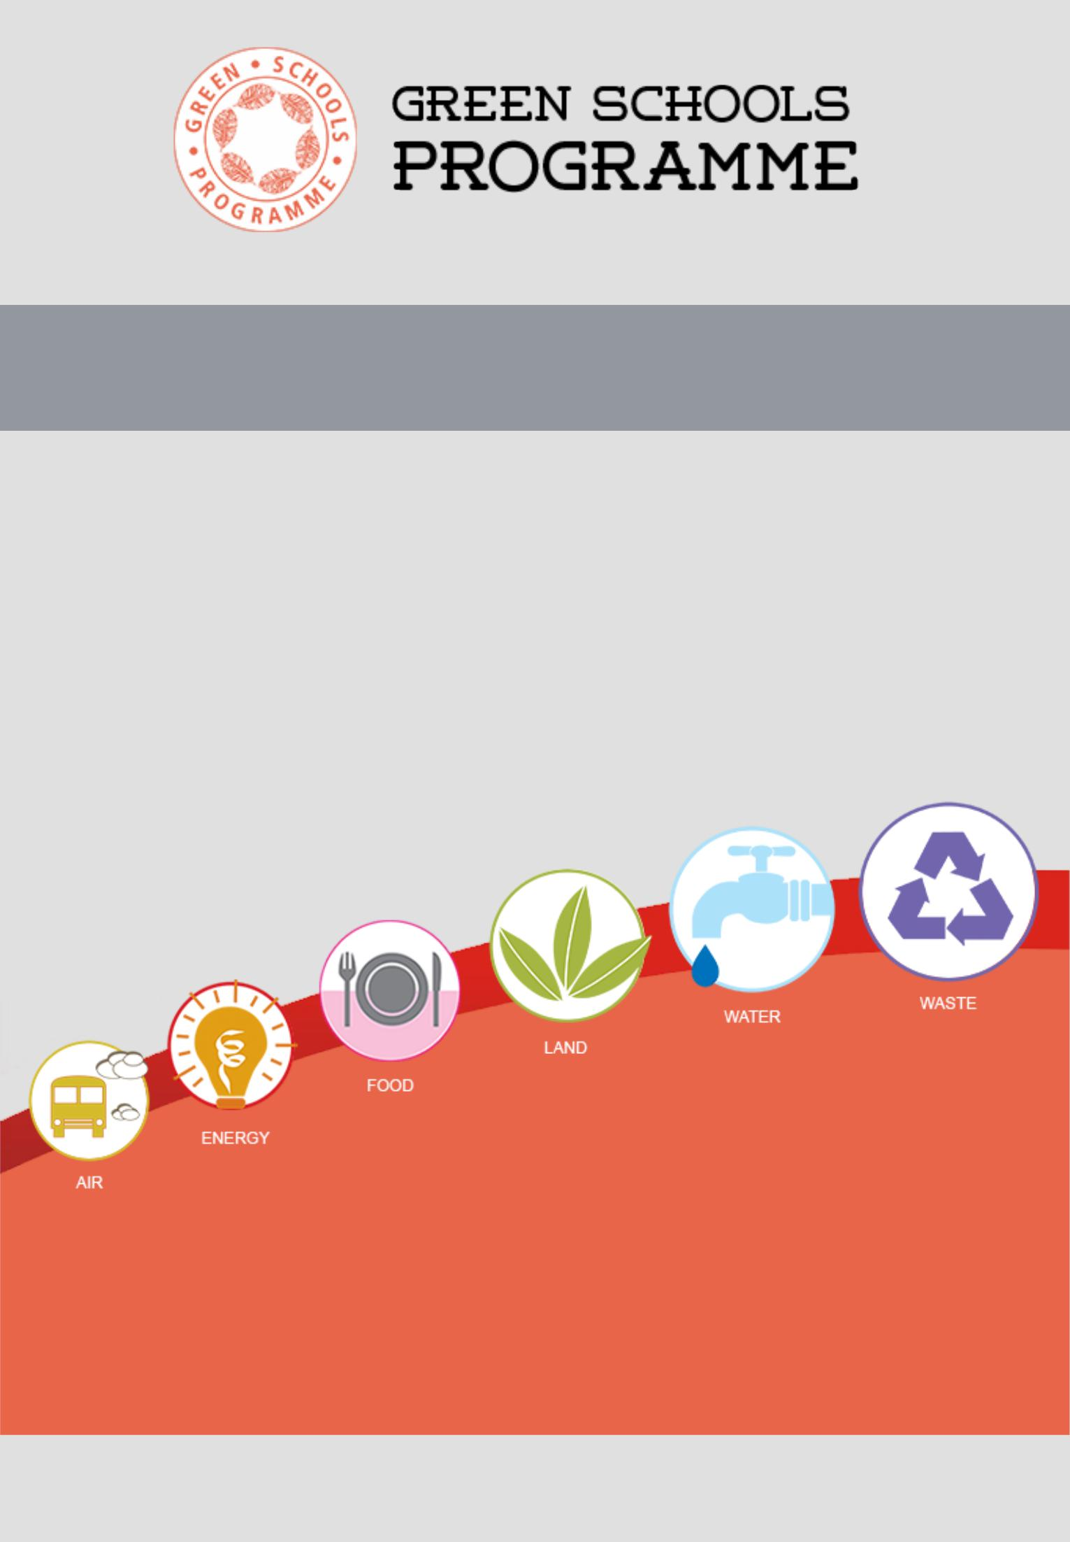
Report on Green Schools Programme Audit 2017
KENDRIYA VIDYALAYA NO 3, BHOPAL

Slide 2
GSP Audit 2018
GSP Audit 2018 will commence in the month of July-Aug 2018 and will be available online.
The Chief objectives of the audit are two fold:
Focus on Water and Sanitation :-
Schools and their students can lead from the front in turning the tide. Students to discover the forgotten practice of rainwater harvesting and learn to conserve water responsibly.
Waste Management
Where to dispose waste?
How to dispose waste?
What to do with the waste?
Easiest solution could be waste segregation.
Feed it into our system - We will segregate our waste even if it is in the mixed form.

Slide 3
GSP Audit 2017-2018 is as follows: Performance Report
KENDRIYA VIDYALAYA NO 3, BHOPAL
School Rating: Orange
Rating | Score (Percentage) | Number of Schools
GREEN | 70% & above | 71
YELLOW | Between 50-69.9% | 208
ORANGE | Between 35-49.9% | 352
RED | Below 34.9% | 69

Slide 4
Air
Green Schools Programme
Audit 2017-2018
AREA FOR AUDIT: 6
Air
Energy
Food
Land
Water
Waste

Slide 5
AIR
School fulfils certain norms of Air Quality . We can improve by considering the recommendations through the assessment below. Overall, the school has done average in air section.
Classroom Window Floor Ratio (WFR)
Window-floor ratio is more than ten per cent . It is 14.27 % Average WFR
Ownership of Vehicles
The School does not use or own vehicles.
This encourages the students, teaching staff and others to use sustainable modes of
transport to commute to school and back.
Mode of Commuting
More than 50% of people coming and going from school are using sustainable motorized vehicles and less than 50% are using Non- polluting modes of transport-

Slide 6
Energy
The impact of 'Global Warming' has already reached scorching levels, and is rising rapidly. Saving energy is the first step to energy conservation. Switching off electrical gadgets when they are not in use and switching to the usage of bulbs to CFLs/ LEDs are great ways to start energy conservation.
Energy per capita per day consumption-
School's Consumption meets the standards set for requirement
Per day per person average consumption of energy meets the norm.

Slide 7
Food
Does the school distribute packaged food items as rewards during schools events:- YES, at times
School's Performance
You have done well but need to further promote the healthy food culture in school .

Slide 8
Are your school events such as quiz shows, talent shows, debates sponsored by food companies/brands?
No

Slide 9
Land
School's Performance:-Good,
School has plenty of green cover and that too, without using any chemical-based pesticides.
The norms say that minimum 35 % of total land should be green cover.
Total Green Cover
The school has a green cover area of 8.23%. so the aim is to increase the cover by at least 10-15 percent in the next two years

Slide 10
How many species of plants and animals exist in your school ?
Equal to or more than 100 plants
The efforts to conserve biodiversity within the school campus is appreciated. The school has maintained plant biodiversity very well.
Less than 50 animal species
Biodiversity is very important to conserve nature. It is recommended to increase fauna biodiversity by ensuring minimum 50 species of animals within the school campus.
Use of Pesticide
No
School does not use any sort of chemical pesticides.
Vermi Compost pit has been developed to make our own organic fertilizer.

Slide 11
Water
The Per Capita Water Consumption of the school is 8.05 litres per person/day which is less than what has been prescribed.
Type of School | Average consumption(in Litres)
Day Scholar | 13-17

Slide 12
Rainwater Harvesting:-No
Plan of Action:- School is planning to catch rainwater from the catchments (roof, paved and unpaved areas)
Is the water supply sufficient?
Yes
Category | Load per drinking | Load per ablution | Load per urinal | Load per water
 | water tap | tap |  | closet
Day Scholar | 50 people | 50 people | 50 people | 45 people

Slide 13
WASTE-
Segregation of Solid Waste
Yes
School segregates Waste at source. Inculcating this habit of waste segregation at source among students can help reform the waste related problem at a bigger level.
Waste Collection Points
Waste segregation at the source is not sufficiently effective at present.
Plan to purchase sanitary disposal machine.
Quantity of Waste Generated
School's per capita waste generation is 5.6 gms per person which is according to the norms (100 gms per peron) for the school type.

Slide 14
Waste Composting
Yes
The school has a composting facility and we are using it to the full potential.
Textbook Reuse
Yes
It is great that Book donation is encouraged by the school community to reuse textbooks.
Waste Destination - Burning of Waste
No
We do not burn waste, we recycle it by selling to the local waste dealer.

Slide 15
Thank you

