Slide 1
GeM
Government e-Marketplace
SAURABH JAITLY
PRINCIPAL,
KV NO. 1 BHOPAL

Slide 2
GeM - Objective
Provide government users the speed and flexibility of e-commerce site in sourcing its requirement
Relieve from routine tendering activities
To have technology enabled dynamic, self sustaining, user friendly, fair and transparent procurement system

Slide 3
Mandated by GFR – Rule 149 of GFR 2017
The Procurement of Goods and Services by Ministries or Departments will be mandatory for Goods or Services available on GeM.
Financial Limits
(i) Up to Rs.50,000/- through any of the available suppliers on the GeM, meeting the requisite quality, specification and delivery period.
(ii) Above Rs.50,000/- and up to Rs.30,00,000/- through the GeM Seller having lowest price amongst the available sellers, of at least three different manufacturers, on GeM, meeting the requisite quality, specification and delivery period.

Slide 4
Financial Limit Continued...
The tools for online bidding and online reverse auction available on GeM can be used by the Buyer if decided by the competent authority.
(iii) Above Rs.30,00,000/- through the supplier having lowest price meeting the requisite quality, specification and delivery period after mandatorily obtaining bids, using online bidding or reverse auction tool provided on GeM.

Slide 5
Financial Limit continued….
Procuring authority to satisfy that the price of the selected offer is reasonable and meet the requisite quality, specifications and delivery period.

Slide 6
Important Terms and Conditions
Terms of Delivery - Free Delivery at Consignee Site (check for installation charges)
Rates - inclusive of all duties and taxes
Currency - INR only
Gives an undertaking that the offered prices in the GeM shall in no case exceed Maximum Retail Price (MRP).
E-signed offer at the terms and conditions of GeM

Slide 7
Parties in GeM
Primary user (Principal)
(can create/modify secondary user(s))(Cannot place order(s))
Buyer (to be decided by Principal (VP/ Sr. Teacher /ASO /SSA /JSA etc.)(Can place orders)
Consignee (to be decided by Principal(VP/ Sr. Teacher /ASO /SSA /JSA etc.) (Cannot place order(s))
All above must have email id issued by KVS (i.e. *** @kvs.gov.in)*, Aadhaar number and working mobile number linked with Aadhaar for OTP)
Seller
Each has its predefined role and responsibilities

Slide 8
USERS (FOR KV)
Primary User (Principal)
Secondary User ( persons with @gov email id (VP/Sr. Tchr/ASO/SSA/JSA)
Organization Registration
Secondary User Registration
Fill the required fields to register the
organization with GeM.
• Buyer • Consignee
• DDO • PAO
Within
48 Hrs
BUYER
CONSIGNEE
Seller Confirmation
and Delivery of Goods
• Select Product
• Select mode of Procurement (DP/L1/Bidding/RA)
• Upload scanned Financial Approval –
(Supply Order)
• e-VERIFICATION (through OTP)
• Receipt of Goods
• PRC Generation
• Inspection of Goods
• Right to Reject Order WITHIN 10 Days
Price Holding – 10 days
Default Delivery Period
Within 10/15 days
CRAC Generation
(through OTP)
Within 10 Days
PAYMENT AUTHORITY
Seller Confirms and
Order Closed.

Slide 9
One time activities.....
1.BUYER REGISTRATION
Primary User(HOD)(Principal) will register on behalf of Vidyalaya using her/his Aadhaar Number and Aadhaar linked mobile number

Slide 10
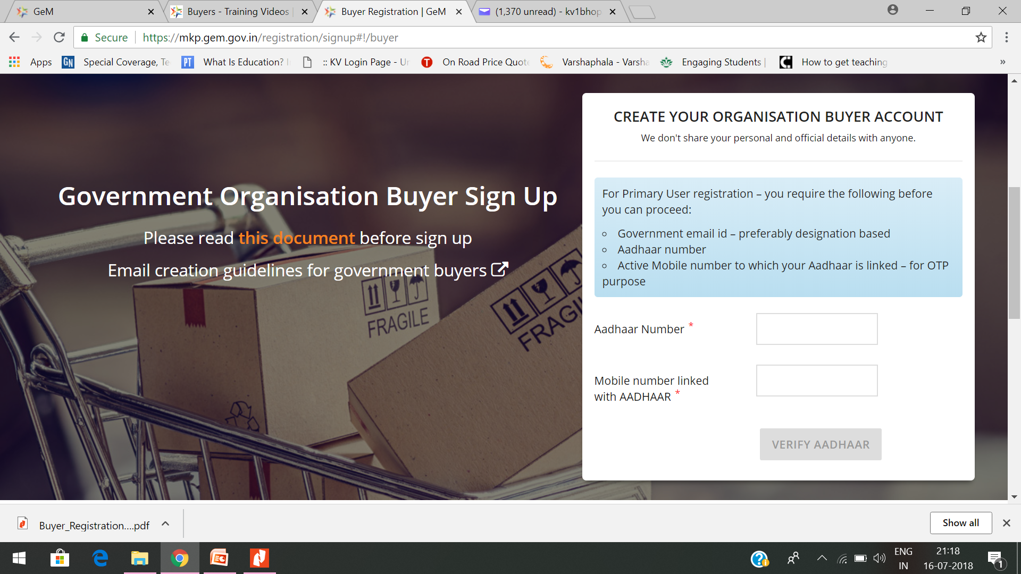

Slide 11
2. AADHAAR VERIFICATION
Aadhaar is to be verified
(through OTP to Aadhaar linked mobile number)
First name & last name is Auto populated from Aadhaar data base.

Slide 12
3. CREATING ORGANISATION’s BUYER ACCOUNT
Primary user(Principal) has to select Origanization Type (Autonomous ), Ministry (MHRD), Department(School Education) from drop down & Office zone to be filled manually.
Primary user has to enter his/her official mail id(****@kvs.gov.in)/Verify email id for verification purpose, OTP will be sent to this mail id, Post OTP verification system will allow to create user name and password
Primary user has to accept terms & condition of Government e-Marketplace (GeM) to create
Account

Slide 13
4. FILLING ORGANIZATION DETAILS
Post Aadhaar verification pop up appears to fill all the details of organization
Organization (Vidyalaya) Address: Based on pincode, state & District will be auto populated, Street Address, Official website, office number with extension to be filled manually
Bank details for VVN A/c to be provided

Slide 14
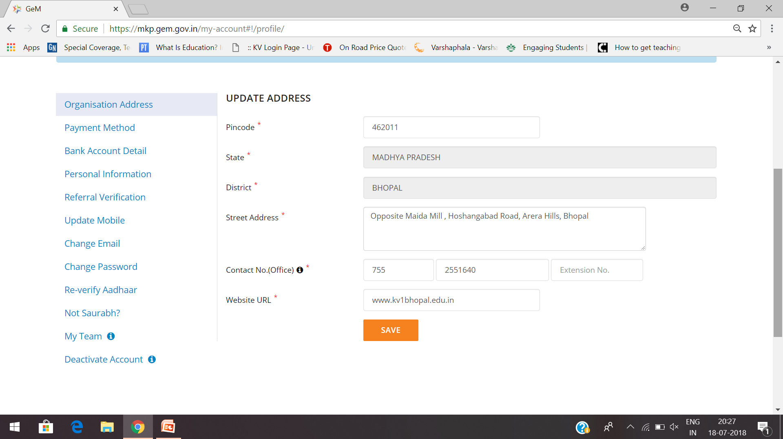

Slide 15
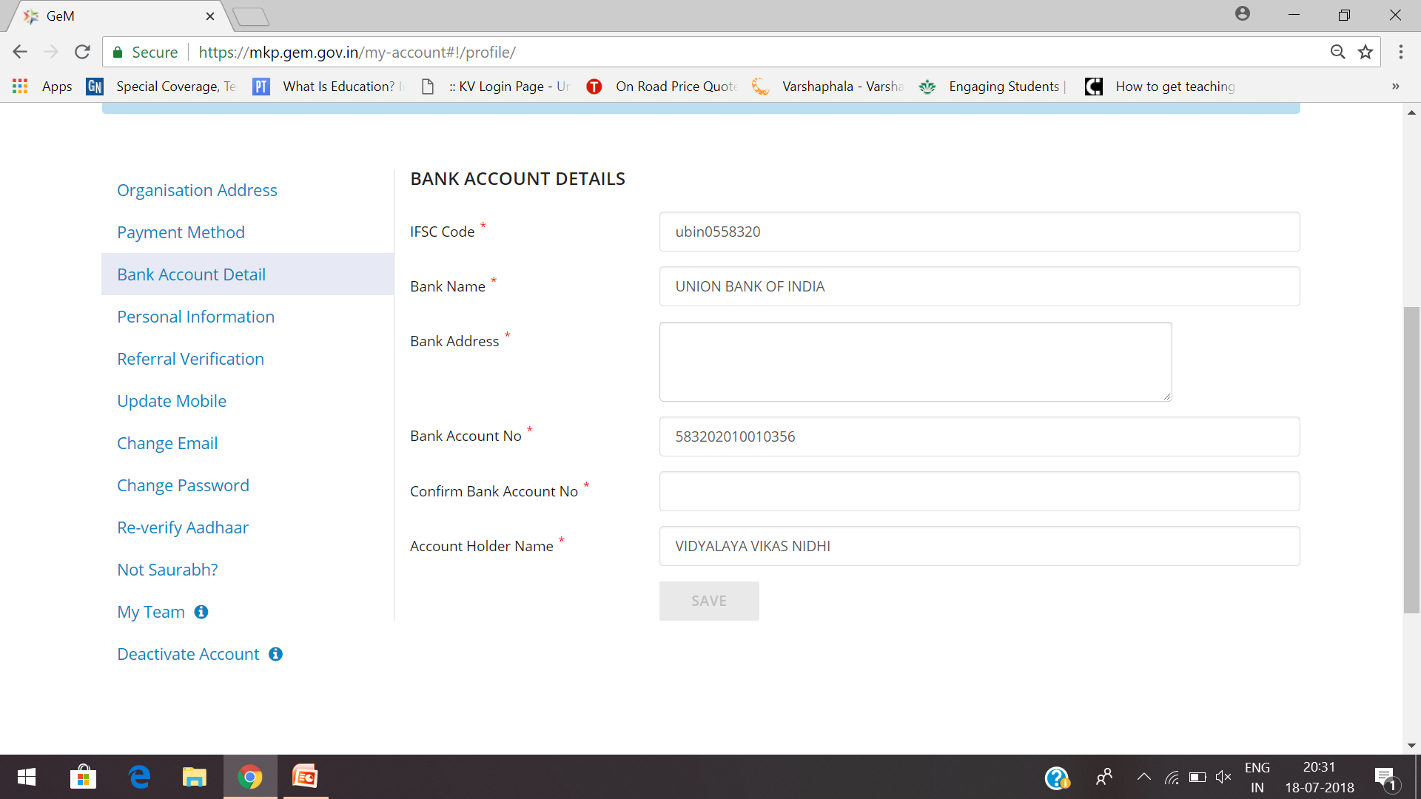

Slide 16
5. PAYMENT METHOD
Here we have to select ‘others’
6. PERSONAL INFORMATION
First name & last name (of Principal) will be auto populated from Aadhaar, designation will be primary user and optional organization GSTIN to be filled manually, NOT APPLICABLE FOR OUR ORGANIZATION (KVS)

Slide 17
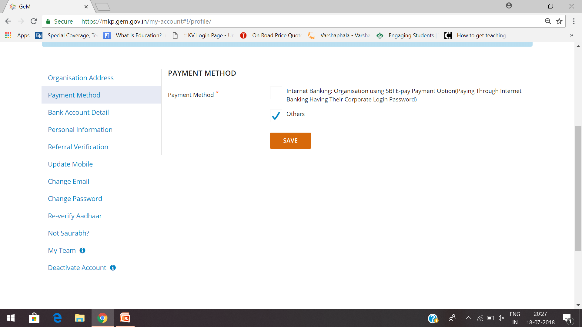

Slide 18
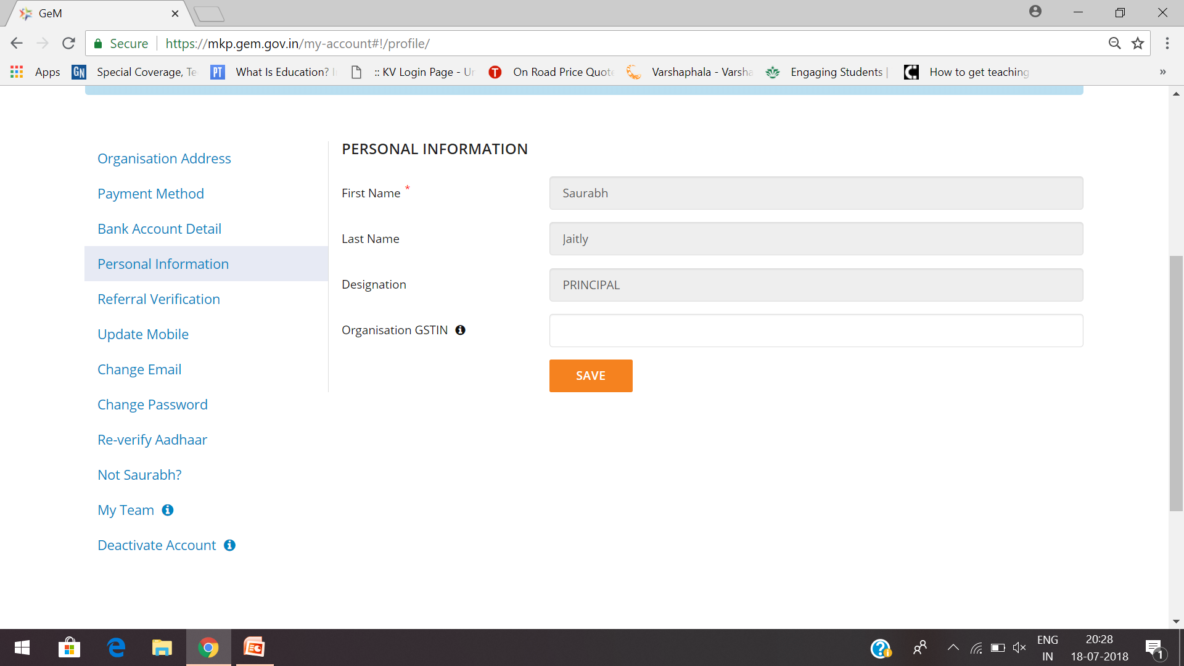

Slide 19
7. VERIFY/AUTHORITY DETAILS
Primary user has to provide the details of an authority to verify his/her account by providing following details:
First name (Deputy Commissioner)
Last name
Official Email id : (Can contact RO)
Official Mobile number (Can contact RO)
Verification mail will be sent to verifier with organization details and primary user details and also deactivation link, if verifier does not deactivate HoD’s (Principal’s) account within 48 hours, system will consider as HoD account as auto approved.

Slide 20
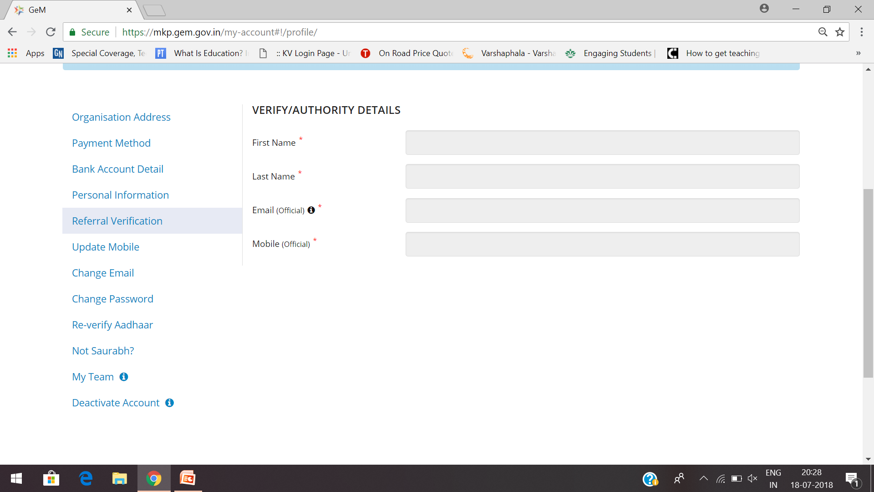

Slide 21
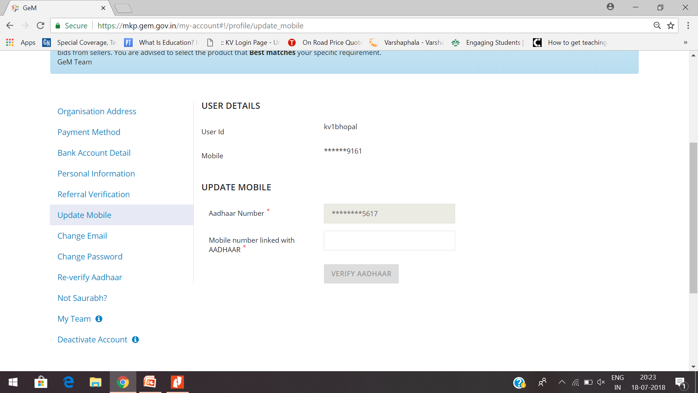

Slide 22
8. DIVISION INFORMATION
Primary user has to fill division information(Can create according to need. Like KV1, Bhopal) so that secondary users can be associated with it. The address of division will serve as the consignee address( delivery address) for the associated consignee user. HoD (Principal) can add multiple divisions if required.
Following details are required to create a division:
Division Name & Address Pin code(of KV) has to be entered manually, based on pin code, state and district will be auto populated.

Slide 23
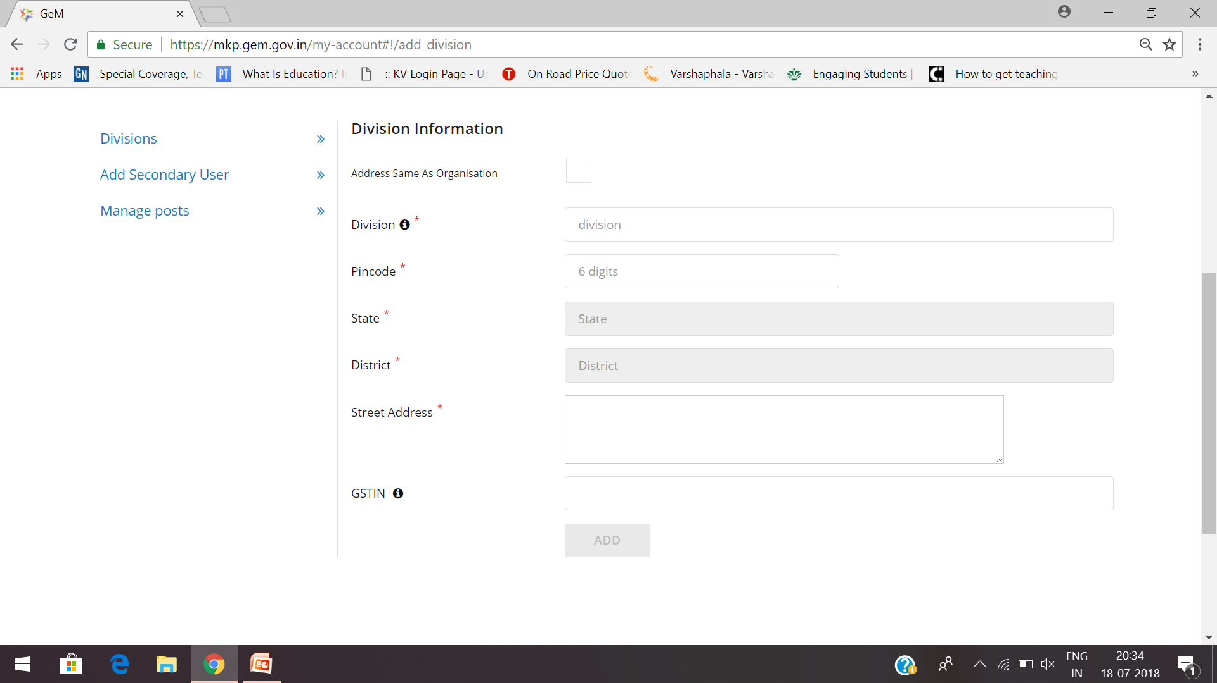

Slide 25
9. CREATION OF SECONDARY USERS Post creation of a division, primary user can add secondary users by clicking on Add secondary user By Clicking on add user you would come to the page in which we have to create roles first

Slide 26
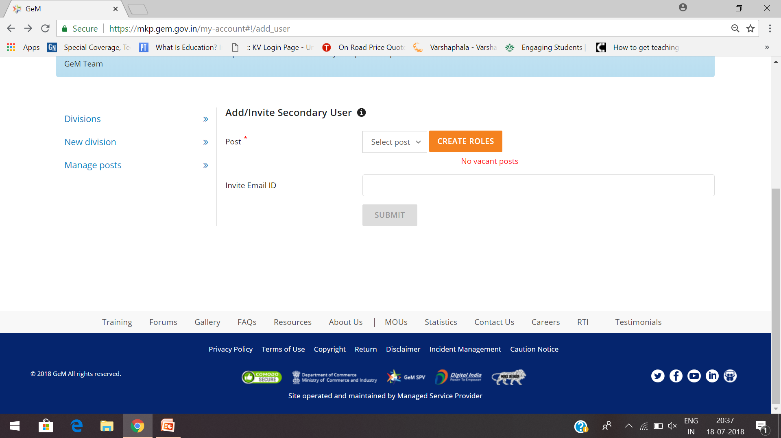

Slide 27
10. Creating Roles
To create roles, primary user needs to first add designation name(VP, PGT, TGT, PRT, ASO, SSA, JSA etc.)
Select division in drop down (Created earlier by Principal)
Select applicable roles (Buyer/ Consignee) for that designation and optionally invite a user to occupy that role by giving the user’s email ID

Slide 28
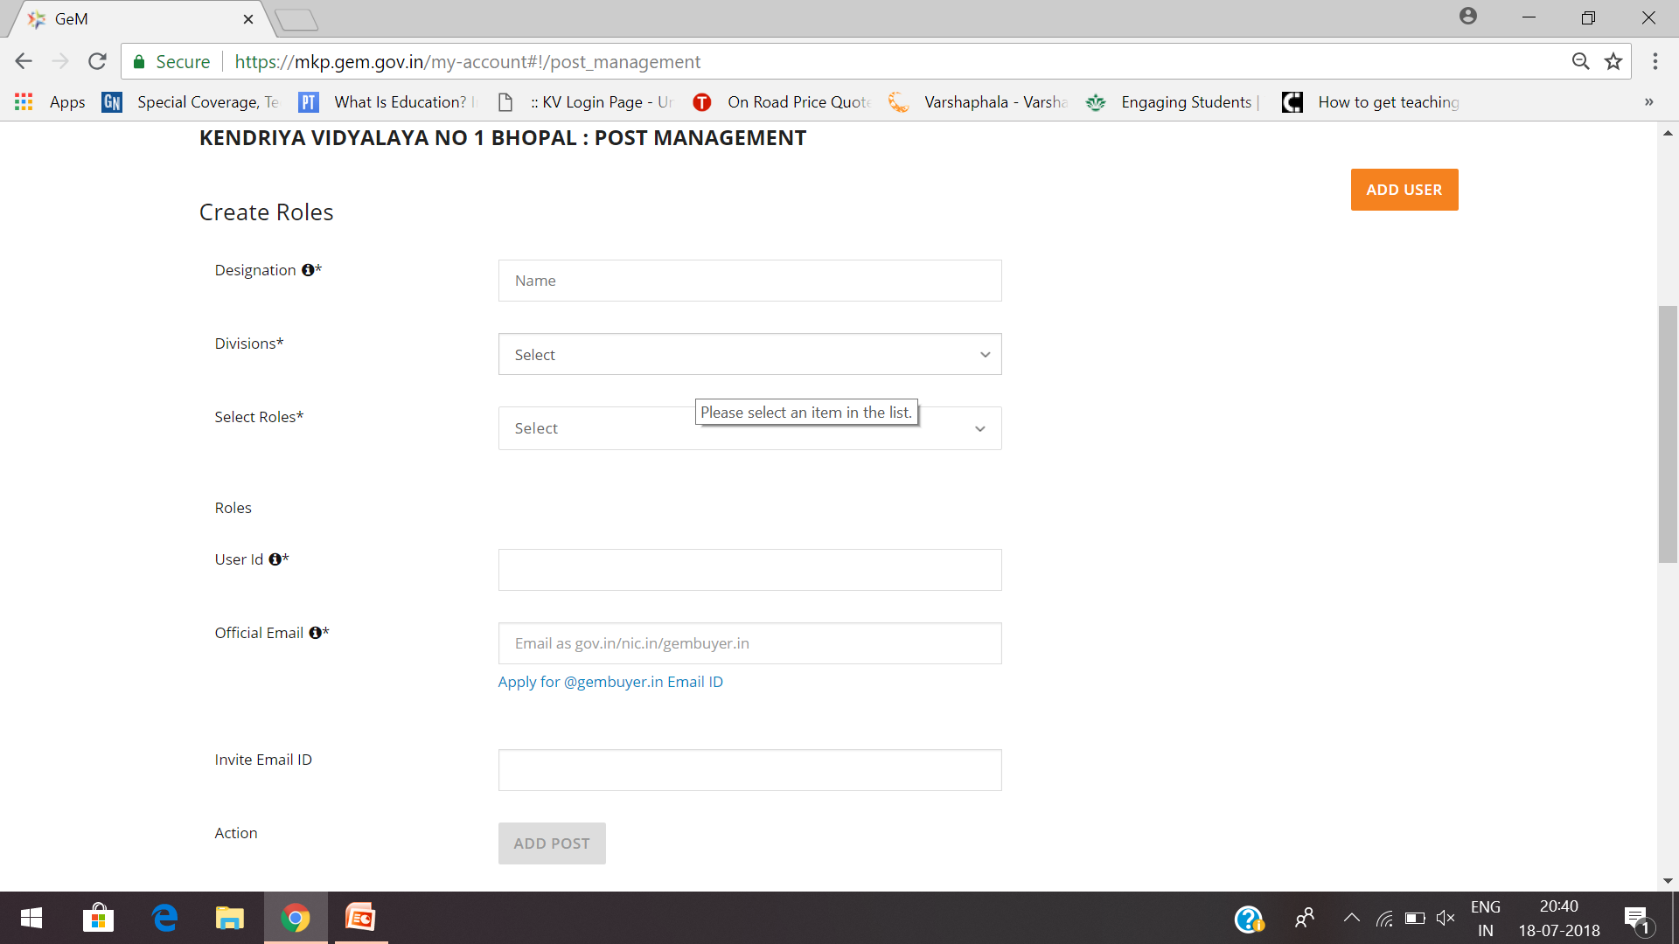

Slide 29
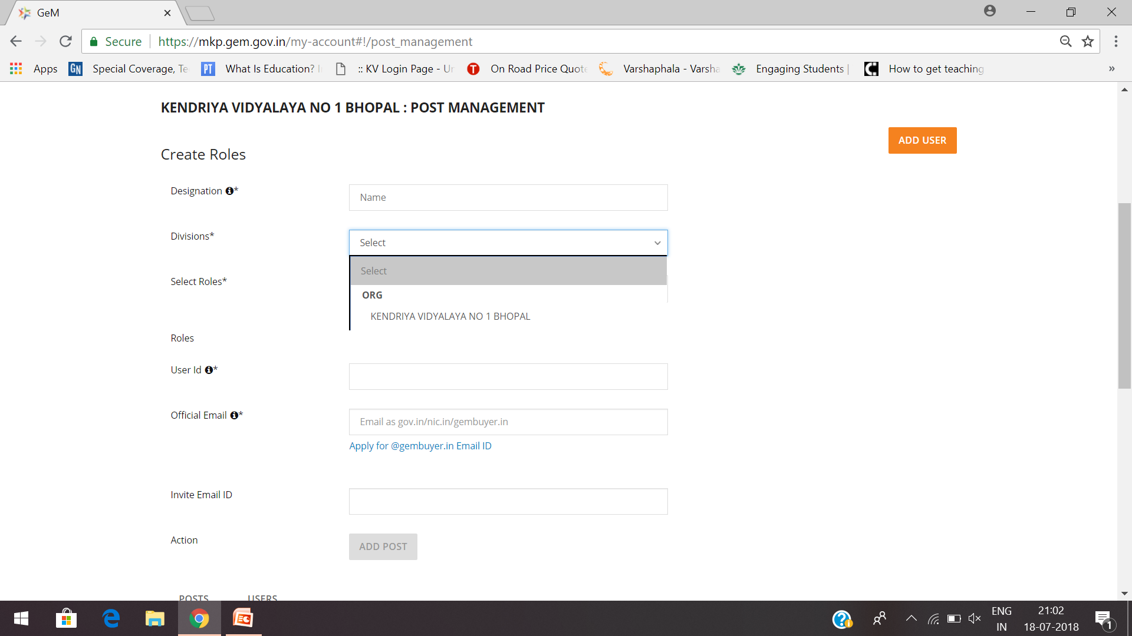

Slide 30
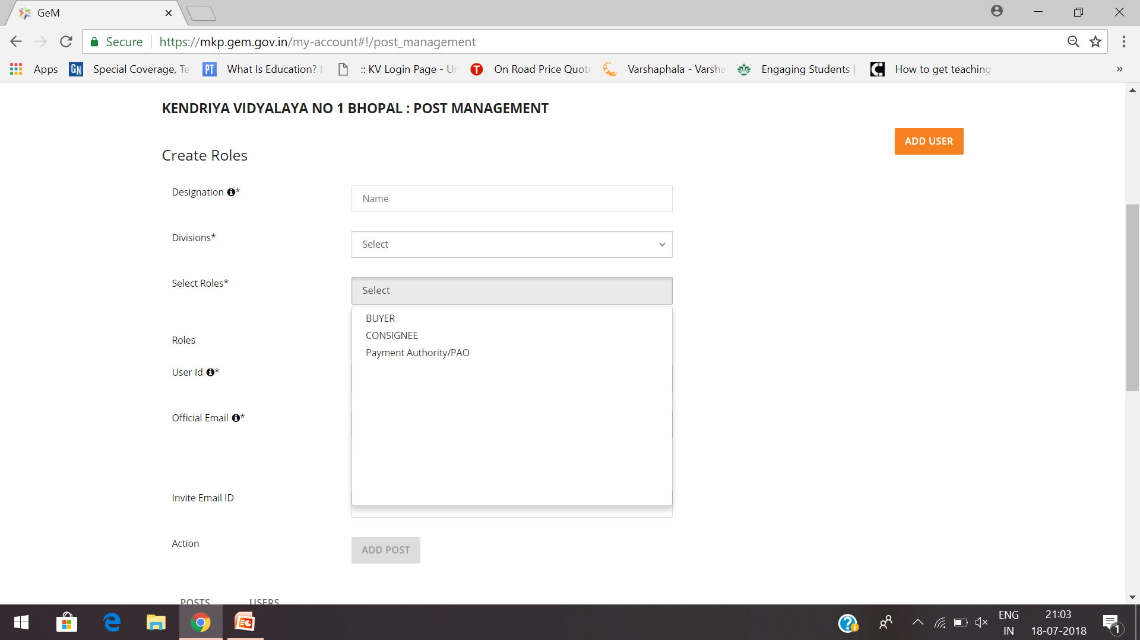

Slide 31
11. Invite Secondary User (Add user)

Slide 32
To BE DONE BY SECONDARY USER(S) 12. Secondary User Account Activation
A link will be sent to (***@kvs.gov.in) email of the secondary user (as entered by the primary user)
Invited user has to fill his/her Aadhaar details to verify same first.(First Slide) (OTP will be sent to the Aadhaar linked mobile number)
Post Aadhaar verified First name, Last name is auto filled and invited user has to create user id and password (Second Slide)

Slide 33
Secondary User Account Activation Form

Slide 34
Your Account will be successfully created.

Slide 35
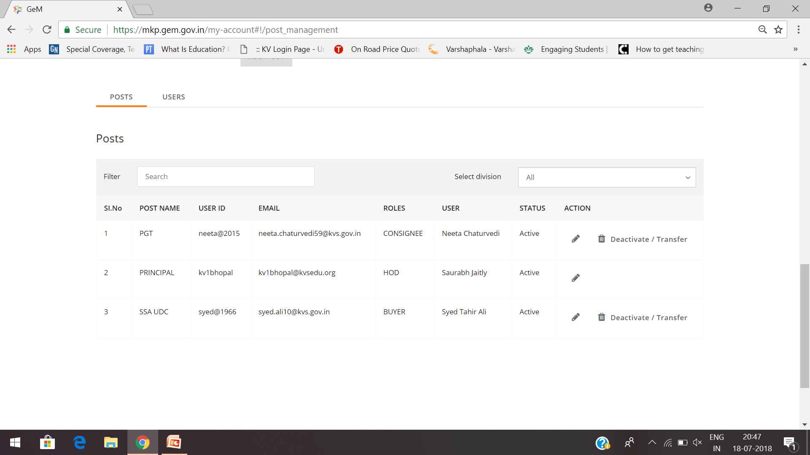

Slide 36
Kudos ...... Now you can start buying through GeM. (only buyer can place order(s))

Slide 37
DIRECT PURCHASE (buyer’s login)
Now to search the desired product, enter the product title or category in the search box and select the respective items from the search suggestion list.
Select Delivery Locations*(Select Consginee and Qty.)
List of all the products with the
matching title will be listed in the search page, with L1 product on the top.

Slide 39
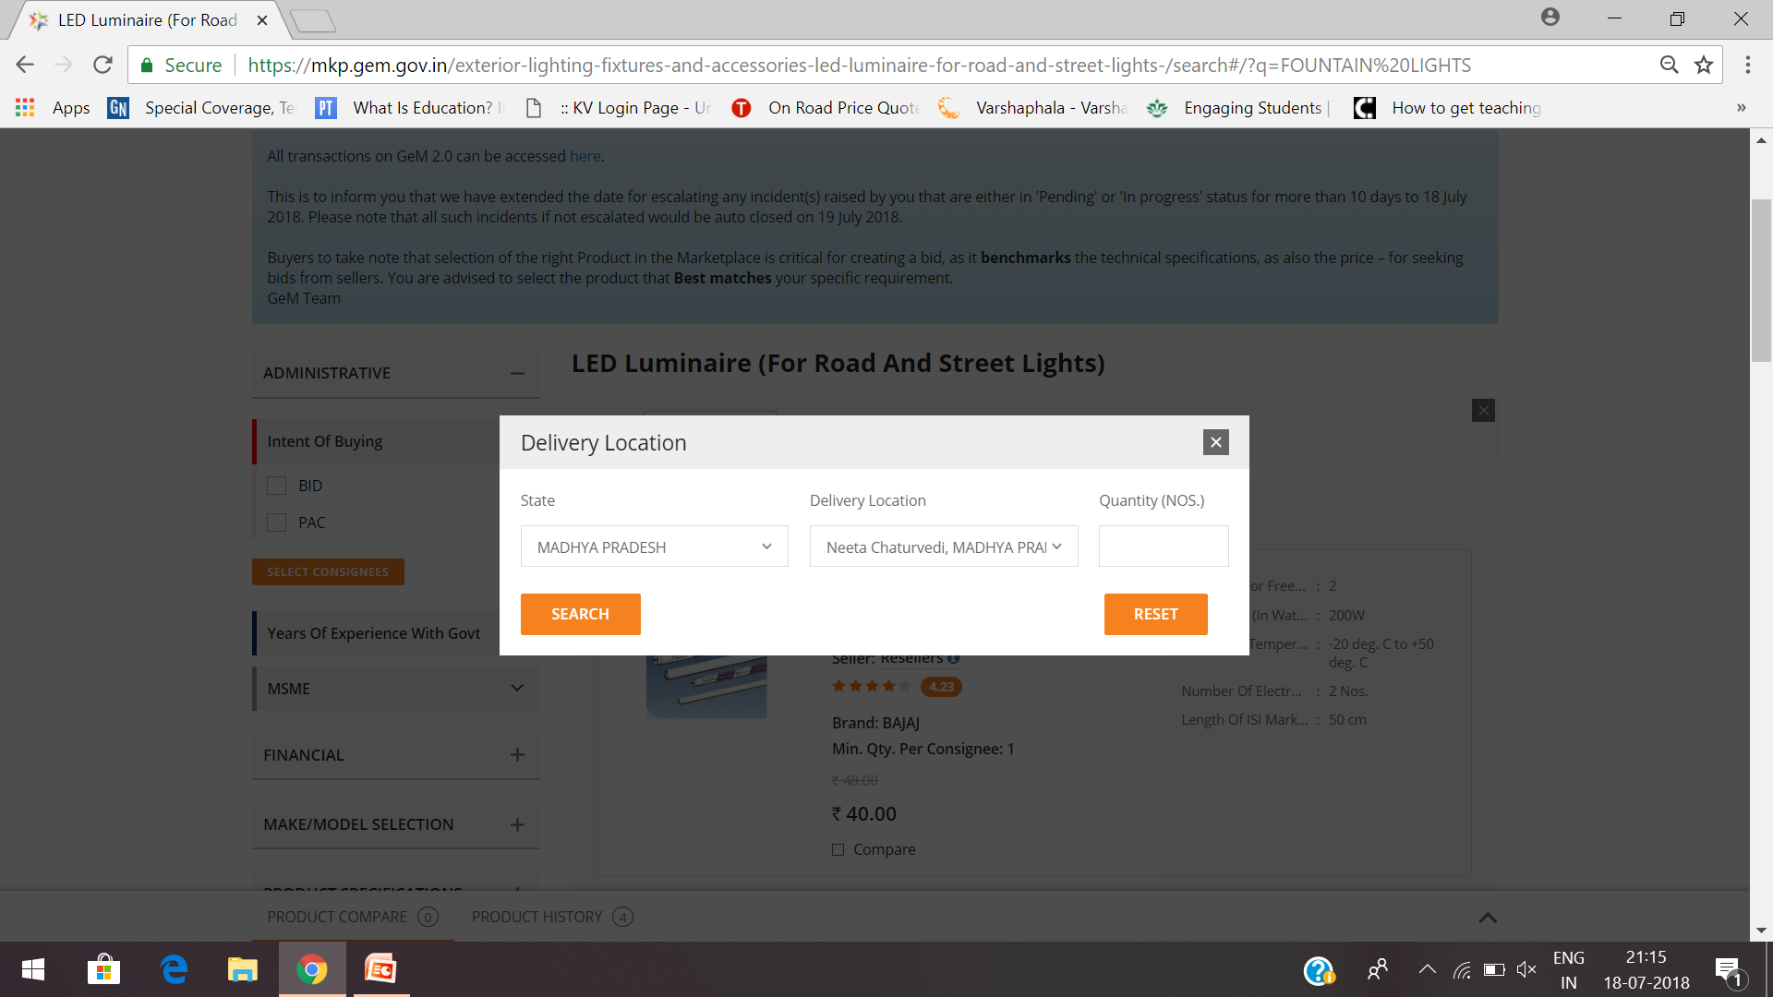

Slide 40
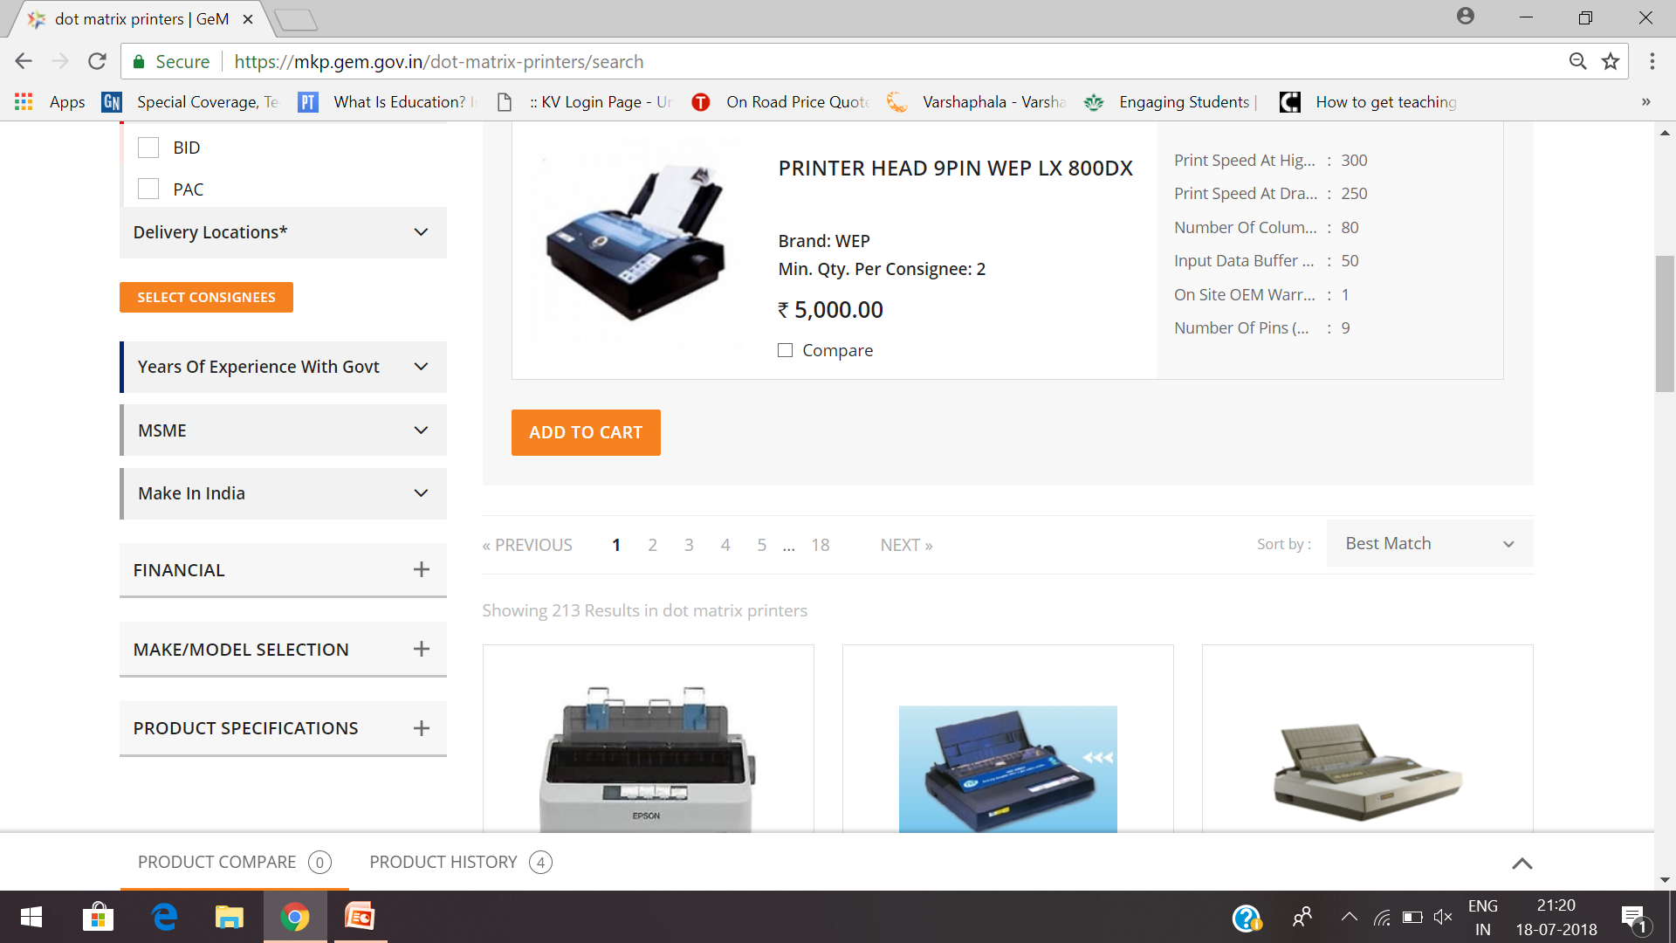

Slide 42
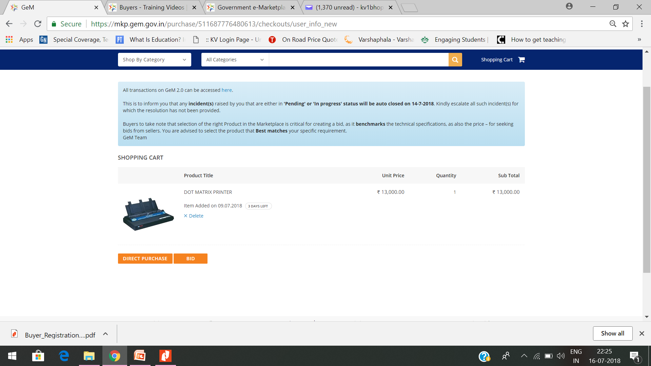

Slide 43
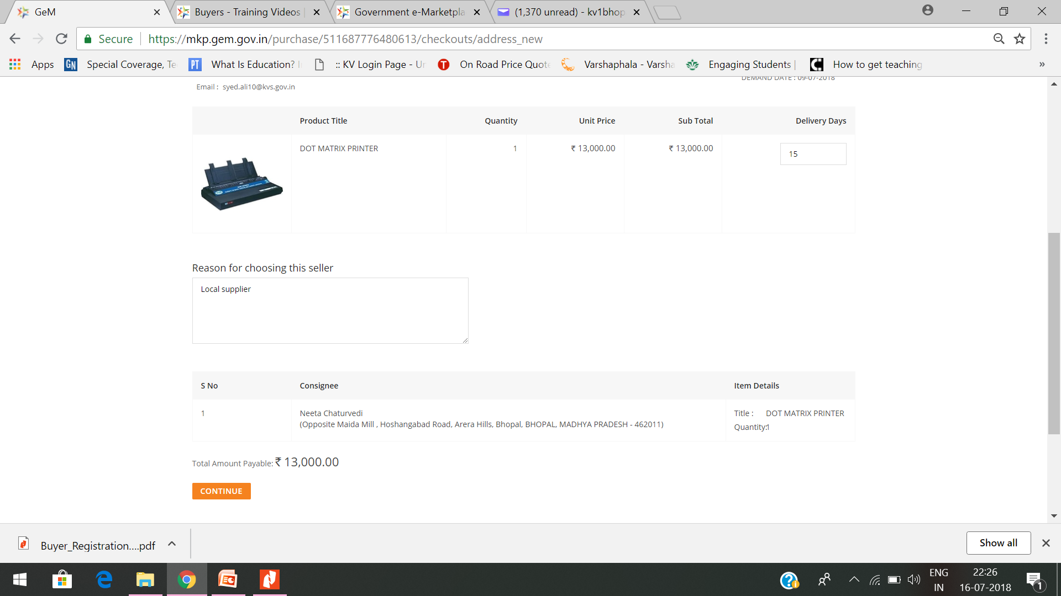

Slide 44
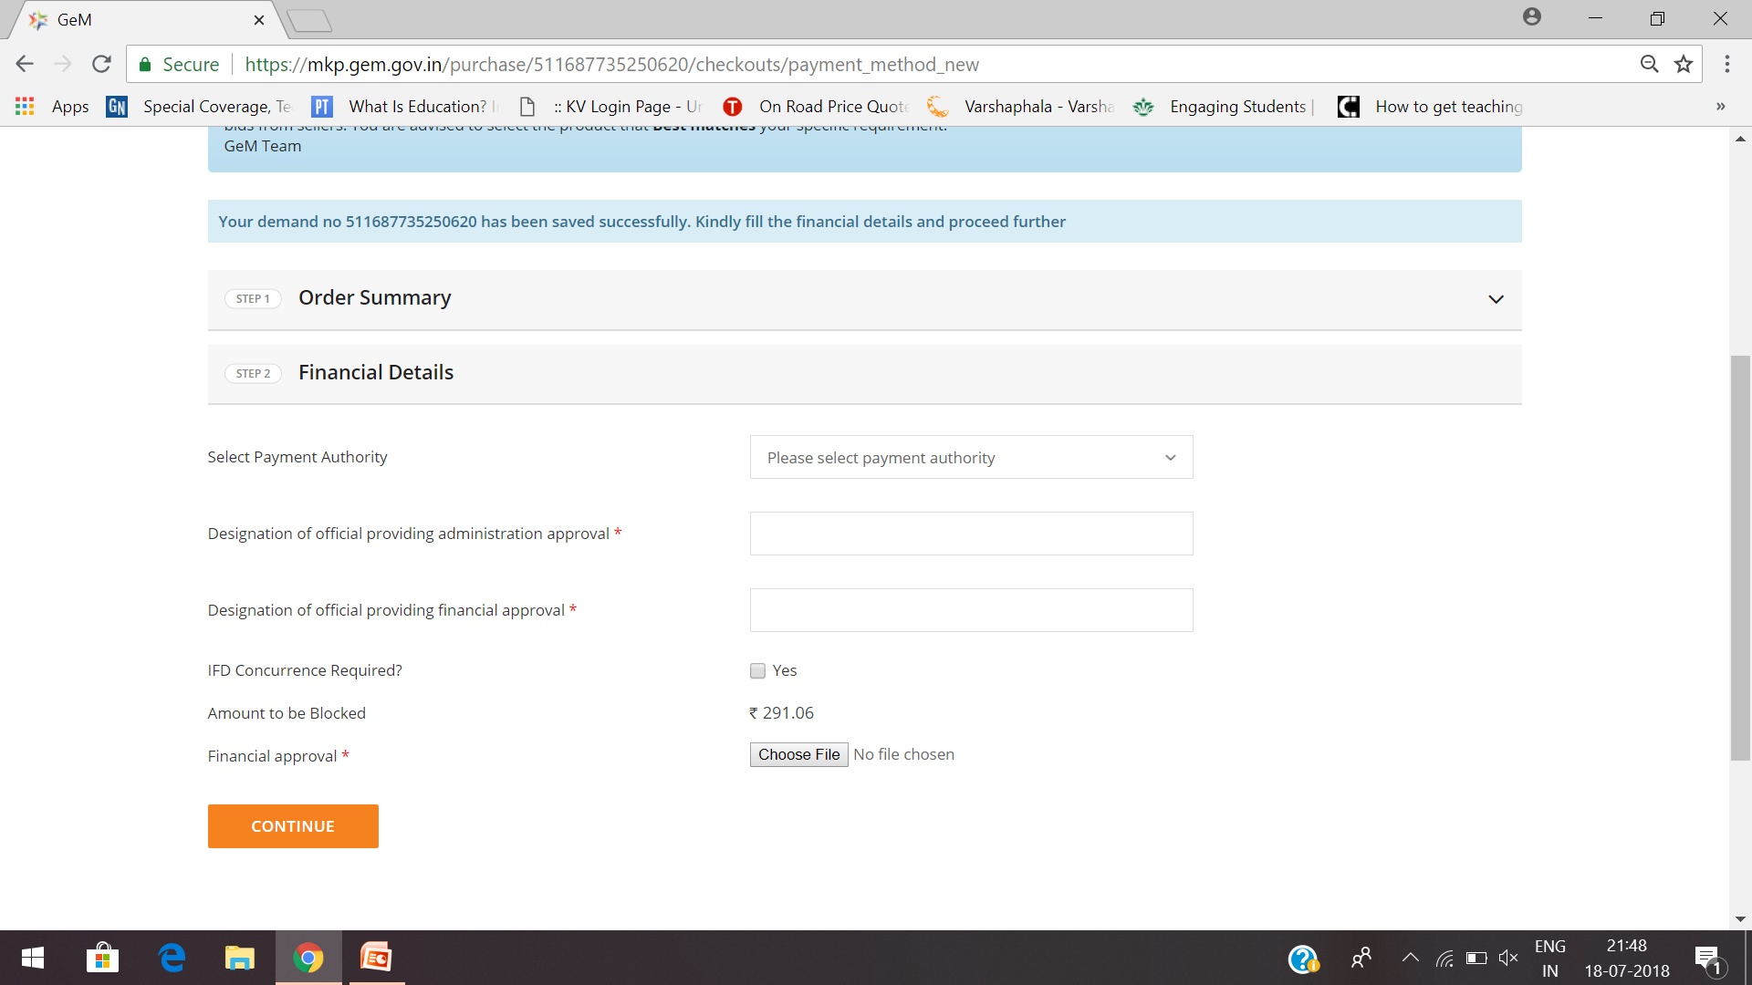

Slide 45
Through Comparative Statement
If the purchase amount is more than 50000, the product has to be compared with items from other sellers before adding the item to cart, which is a mandatory step. (should not be from same brand and seller)

Slide 47
Comparison screen will list the specifications of the comparable items in the same screen, with the L1 item being displayed at first.
Click on Add to Cart to add the respective item to the cart.
Though the purchase value of the product is above Rs. 50,000/-, if the item added in the cart is L1 item we get Direct Purchase.
Click on Direct Purchase to proceed with Direct Purchase.

Slide 48
Review the order and click on Continue to generate the Demand.
Post Demand Generation Financial Approval has to be uploaded and verified and the budget has to be blocked for the purchase.
Click on Choose file and select the Finance Approval and upload the file(Supply order).
Click on Continue and verify the uploaded documents.
Continue for e-verification through OTP to Aadhaar linked mobile number of secondary user (Buyer)
SMS will be sent to Primary user and Consignee
Post verification, the order will be moved to the seller Panel for fulfilment.

Slide 49
Login through consignee’s account
Once the order is executed and delivered by the Seller, consignee has to login with his
credentials and click on PRODUCT ORDERS > ALL ORDERS to view all the orders assigned to this consignee.
Click on Process Order to generate the PRC.(Provisional Receipt Certificate)
You can also see other related documents now (sanction order, Contract order & Financial Approval).

Slide 50
At last...
Once quantity is received, consignee has to now sign the CRAC (Consignee Receipt and Acceptance Certificate).
Enter the quantity Accepted.
Enter Reason For Rejected/Conditional Accepted Items.
Select Inspected By either Self or Professional
Now Click on Save and Continue
OTP will be sent to Aadhar linked mobile number for verification
Make payment ....

Slide 51
FAQ...
B1.5:- If a Primary User is transferred, how can an organization proceed with the same account on GeM?
Deactivation of Primary User and Transfer of Account to another Primary user is possible. The Primary User needs to click on Deactivate Account under My Profile and enter the email id of new HoD and Confirm his/her own Deactivation. The account gets transferred to the new Primary User. The Primary User can login with existing user id but new password.

Slide 52
FAQ....
B1.9:- Being a PSU/Autonomous Organisation, we face problem in getting nic/gov email from NIC. What is the solution if I do not have gov/nic email to register as Primary user on GeMportal?
Considering the problems being faced by PSUs/Autonomous organisations in obtaining the nic/gov, at their request, it has now been decided to generate @gembuyer.in email id to Primary Users also on case to case basis to enable them to register & transact on GeM portal. It is thus requested that the details of persons for whom @gembuyer.in email id is required may please be provided at the earliest in the EXCEL FORM ONLY.

Slide 53
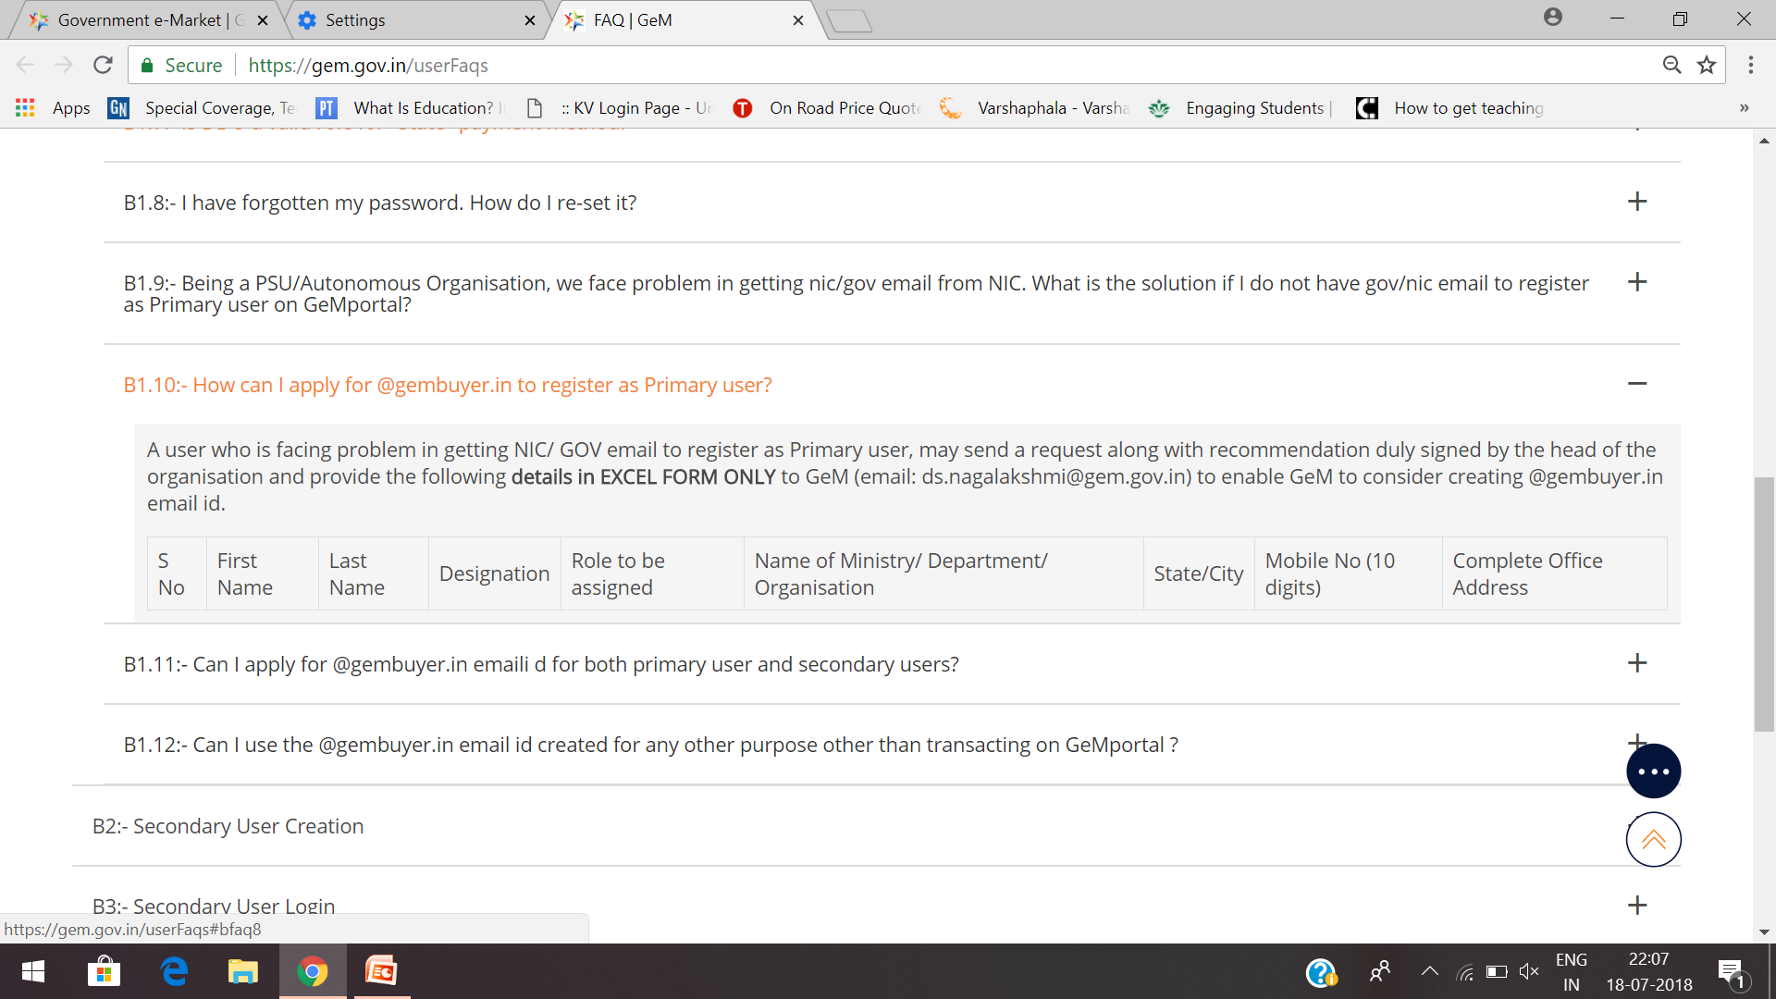
B1.10:- How can I apply for @gembuyer.in to register as Primary user?
A user who is facing problem in getting NIC/ GOV email to register as Primary user, may send a request along with recommendation duly signed by the head of the organisation and provide the following details in EXCEL FORM ONLY to GeM (email: ds.nagalakshmi@gem.gov.in) to enable GeM to consider creating @gembuyer.in email id.S NoFirst NameLast NameDesignationRole to be assignedName of Ministry/ Department/ OrganisationState/CityMobile No (10 digits)Complete Office Address

Slide 54
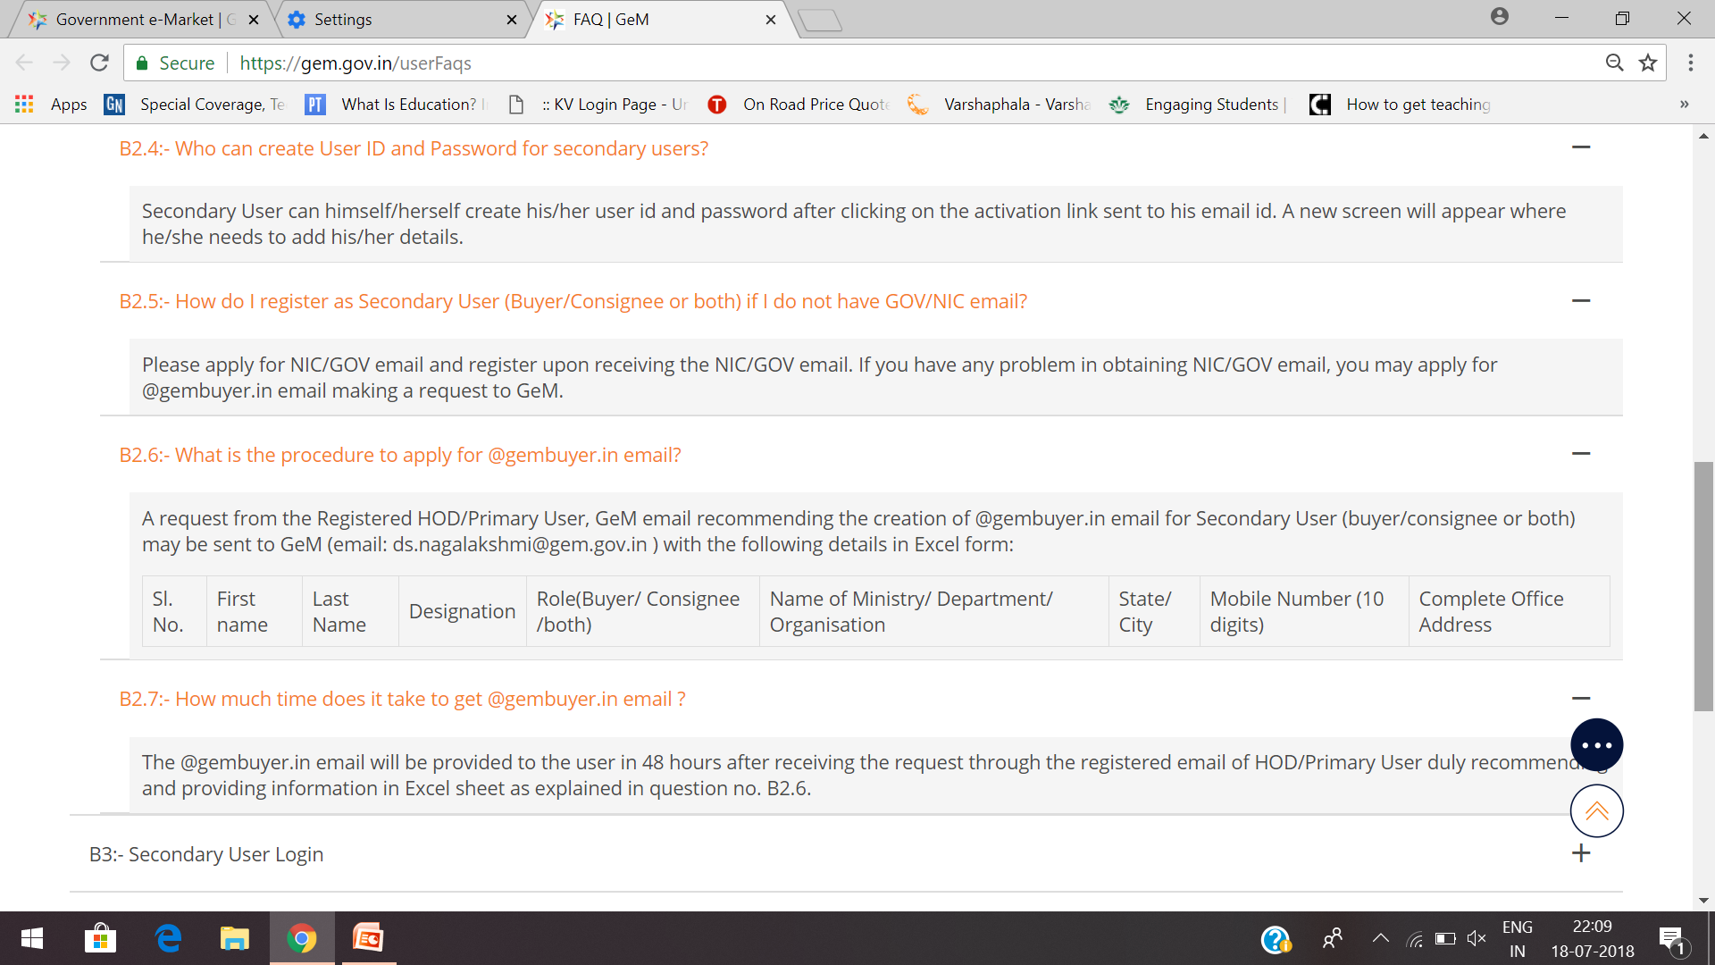

Slide 55
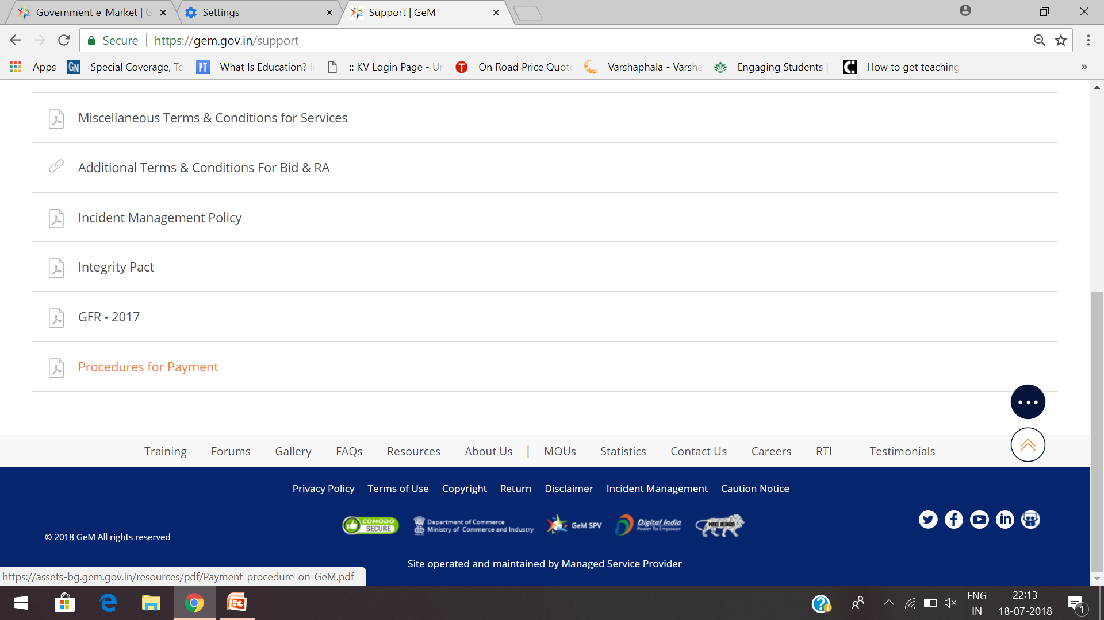

Slide 56
LOOKING FOR ASSISTANCE/ HELP.......
CALL GeM SUPPORT DESK
1-800-419-3436
OR 1-800-102-3436

Slide 57
Thank You
Special thanx to Hon’ble Deputy commissioner Shri Sunil Shrivastava and Assistant Commissioner Smt Shardha Jha for this opportunity.
SAURABH JAITLY,
PRINCIPAL , KV No. 1, BHOPAL
7838799161

